Slide 1

Word-Emoji Embeddings from large scale Messaging Data reflect real-world
Semantic Associations of Expressive Icons
Helge Reelfs¹, Oliver Hohlfeld¹, Markus Strohmaier², Niklas Henckell³
¹ Brandenburg University of Technology
² RWTH Aachen University & GESIS
³ The Jodel Venture GmbH
3rd International Workshop on Emoji Understanding and Applications in Social Media
June 8, 2020
Notes:
WELCOME
I am Helge from BTU
In this talk, I will talk about our explorative study of the Jodel Messaging Application using Word Embeddings
This is joint work with Oliver, Markus (RWTH Aachen) and Niklas (The Jodel Company).
Without further due, lets start with a short motivation.

Slide 2

Motivation
Understanding the semantics of Emoji
We do an explorative study an an OSN/Messging App dataset
Three different approaches
  Emoji 2 Emoji – Analysis of hand-picked examples
  Emoji 2 Text – Analysis of hand-picked examples
  (Text 2 Emoji – ML downstream task [see paper])
Leverage well-established methods: Word Embeddings
But wait, what’s the point then?
Notes:
Desirebale to computationally understand semantics.
Building Block for lots of other tasks.
But Semantics of Emojis is a *hard problem*
Culrutal differences
User Interface differences (platform dependent) – Apple vs Google vs Samsung vs Microsoft
Last, but not least human perception
So, we will do an EXPLORATIVE STUDY on a NEW Online Social Network – the JODEL APP.
Approaches
Emoji 2 Emoji – get similar emojis for a given emoji
Emoji 2 Text – get textual description for a given emoji
Text 2 Emoji – compute an emoji to a given text
WORD EMBEDDINGS
Hot research topic for the laste years
Good tool for any downstream task
Out DATASET is DIFFERENT to many others using Twitter or Google News!
Before that, some words about our PUBLICLY RELEASED DATASET

Slide 3

Public JEED-1488 Dataset
Jodel Emoji Embedding Dataset containing 1488 emoji
Due to privacy concerns, we cannot publish the text-related parts
However, we have released our Emoji-only Subembedding
Hopefully, it will be useful for the research community!
Dowload now at https://github.com/tuedelue/jeed
Notes:
BEFORE we get into details about Jodel:
I present you the Jodel Emoji Embedding Dataset containing 1488 different emojis
GDPR, NDA, many of you know these deal.
In Short: PRIVACY; we MUST NOT publish ANY TEXT whatsoever.
BUT, the good news is: EMOJI SUBEMBEDDING can be DOWNLOADED HERE
There are 1488 emoji 300 dimensional vectors
Short python DEMO included
Now what is this Messaging App?
How does it look like?
How does it work?

Slide 4
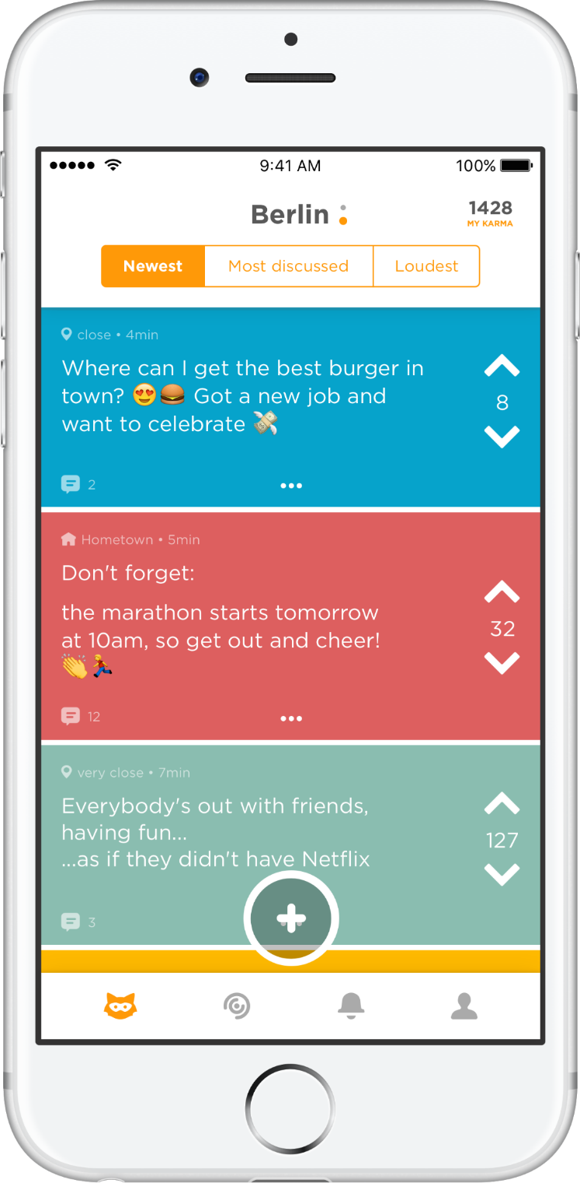


Jodel App
Community
Feed
Related Work often uses e.g.
Twitter or Google News Corpus
Microblogging/Chatting App
  Text
  Images
  (Short videos)
Unique properties
  Location-based
  Anonymous
Set out in Germany late 2014
  Popular across Europe & Gulf states
  Mostly Students & Pupils
a “Jodel”
(thread)
Jodel presumably is chattier
Jodel presumably is more open
Up-/Downvote
& “Karma”
Notes:
Btw Jodel is a German word for Yodelling: calling out loud/singing
*EXPLAIN IMAGE*
MICROBLOGGING
Text
Images
Latest: Short Videos
FOCUS TEXT ONLY
LOCATION BASED
App creates LOCAL communities (comparable to cities) depending on USER’S GPS POSITION
Users CAN COMMUNICATE PUBLICLY in THREADS
App is totally anonymous:
NO USER HANDLES
LIMITED SOCIAL CREDIT
Before you ask: Yes, with suitable moderation in place, this works
Real life chats, real life stories
Twitter / Google = Probably LESS EMOJI
IF YOU DOWNLOAD the APP, do not get too excited. Highly depends on the LOCAL community whether it is fun.

Slide 5

Used Dataset
Ground truth information from operator
  Germany
  10/2014 until 08/2017
Factsheet
Remap skin-color modifier to the neuter
(Skin color sematics is a different story, yet interesting)
Timespan of data does
include up to Emoji 5.0
Metric | #
Used Document Sentences | ~42 M
Sentences with Emojis | ~11 M
Unique Emoji w/o skin color | 1488
Notes:
Ramapping: SKIN COLOR CONFUSING – difference PROBABLY very LOW VERSUS OTHER EMOJIs --- and not often used!
UP TO Version 5.0 was released in MAY 2017 – we find emojis in the dataset
YET, NO PROBLEM for our study

Slide 6


Word Embedding Model
Recap
  Map input words into n-dimensional vector space
  According to simultaneous occurrences
  Often together occurring words have lower distance in vector space
  → (Semantic) Association
Use off the shelf Word2Vec (gensim)
Default parameters – CBOW, window=complete message
N=300 dimensions
Trained epochs of used model: 30 (we looked into others as well)
But aren’t there newer
and better methods?
Yes, there are.
Word2Vec works sufficiently well.
(for now)
Notes:
We have any DOCUMENT with SENTENCES as INPUT
Algorithm calculates POSITION in VECTOR SPACE
According to METRIC: simultaneous occurrence
Words in this space are now closer together IF they occur together more often.
This YIELDS a possibly SEMANTIC ASSOCIATION
Explain Parameters.
YES, there are:
Any NEURAL NETWORKS w/o feedback eg, “A semantics-based measure of emoji similarity” – work by Wijeratne et al
Using CONTEXT:
Google Bert
Sentence Embeddings, eg Siamese CBOW, Kenter et al;
Word2Vec is “simple” and quite old; Yet it worked well for our EXPLORATIVE on the DATASET study as we will see.
So first, let us grasp what our model looks like...

Slide 7

Emoji 2 Emoji - tSNE
t-Distributed Stochastic Neighbor Embedding
  Reduction of high-dimensional data
Ambiguous (projection based on random seed)
Provides first hints, may result in false interpretation
Notes:
I will NOT BOTHER you with TECHNICAL DETAILS
If you are very interested:
“Visualizing High-Dimensional Data Using t-SNE” van der Maaten et al. 2014

Slide 8
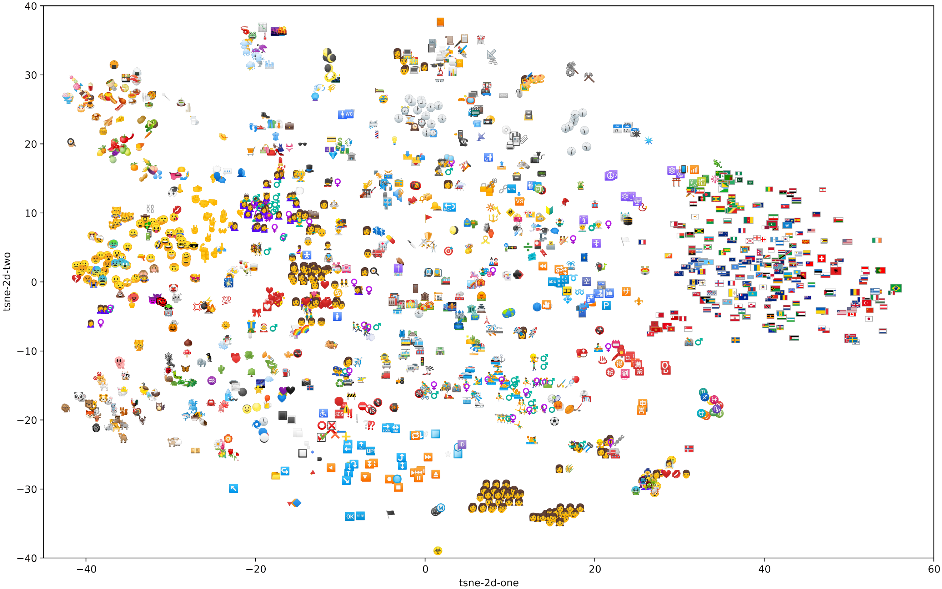

We can spot topic clusters
Notes:
Just ignore the axes as they are purely technical.
Clusters:
ANIMALS
FACES – can be split into negative/positive
FOOD & FRUITS
WEATHER
FLAGS
SPORTS
FAMILIES & MARRIAGE
ADVENTURE, SIGHTSEEING
...
And lots of more details to be discovered in this picture..
So there are topic clusters, but does this really translate to valid associations?

Slide 9




















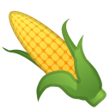
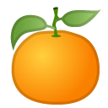









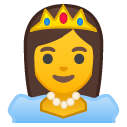



















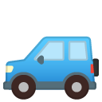
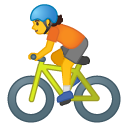

Emoji 2 Emoji – Top 10 Similarity*
Emoji | 1 | 2 | 3 | 4 | 5 | 6 | 7 | 8 | 9 | 10
We can explain lots
of associations
9
*smallest vector space cosine distance
Notes:
Emoji SIMILARITY
COSINE VECTOR DISTANCE
HAND PICKED REPRESENTATIVE EXAMPLES
BEER Party, Alcohol, Positivity
Now the fun part:
PEACH Eggplant, Banana, Tongue, Sweat Droplets, Cherry, smirking face, index point, corn, tangerine, mouth – top 11..20 camera, fire
Lots of other fruits
BUT Tongue, Mouth, Droplets HINT to DIFFERENCT SEMANTIC than FRUIT
Well, you know internet.
CASTLE national park, statue of liberty, house, teacher, ship, night with stars, mount fuji, princess, houses, crown
Mountains, Houses, Princess, Crown ---- teacher? Probably Harry Potter.
WINKY FACE winking with tongue, victory, savoring food, beaming face smiling eyes, grinning smiling eyes, grinning big eyes, with halo (gloriole), grinning squinting, blowing kiss, smirking
Just other POSITIVE Faces – Used VERY much
BUS oncoming bus, automobile, railway car, racing car, dashing away, tram car, sport utility vehicle, biking, bicycle
cars & transportation
As we can explain lots of the associations, lets look into resulting EMOJI 2 TEXT

Slide 10
Emoji 2 Text – Top 10 Similarity*
 | Emoji
 |  | beer, cheers, next time, my, well, first, last, fine, evening
 |  | (buttocks coll.), (breasts coll.), thong, (buttocks coll.), breasts
 |  | castle, hogwarts, ilvermorny, heidelberg, palace, prince, kingdom, island, emojis, beasts
 |  | fun, gladly, please, if, search, ps, search, thanks, beautiful, at least
 |  | (name), bus driver, racing team, (name), bus line, (local transportation), busses, racing, (local transportation)
single
Stereotypical emoji classes
(we spotted so far)
single*
multi
omni
platform
*smallest vector space cosine distance
Notes:
HAND PICKED EXAMPLES
E.g. Castle – top11-20 contains references the shire (LOTR) as well
We can put this into stereotypical classes (from our analysis so far).
There are lots of other good examples!

Slide 11
Conclusions
Dowload JEED1488 dataset now: https://github.com/tuedelue/jeed
Word embeddings can catch semantic associations
Our embedding cannot catch multiple semantics reasonably
Word embeddings work well on OSN chat data
(A simple ML downstream task for Text 2 Emoji works well)
So what next?
  Look into convergence with higher amount of training
  Look for alternative embeddings (e.g., including context)
  Incorporate human labelling for more quantitative results
Notes:
SEE OUR PAPER FOR MORE DETAILS!
THANKS for listening – I am happy to answer questions now.

Slide 12
Backup Slides.

Slide 13
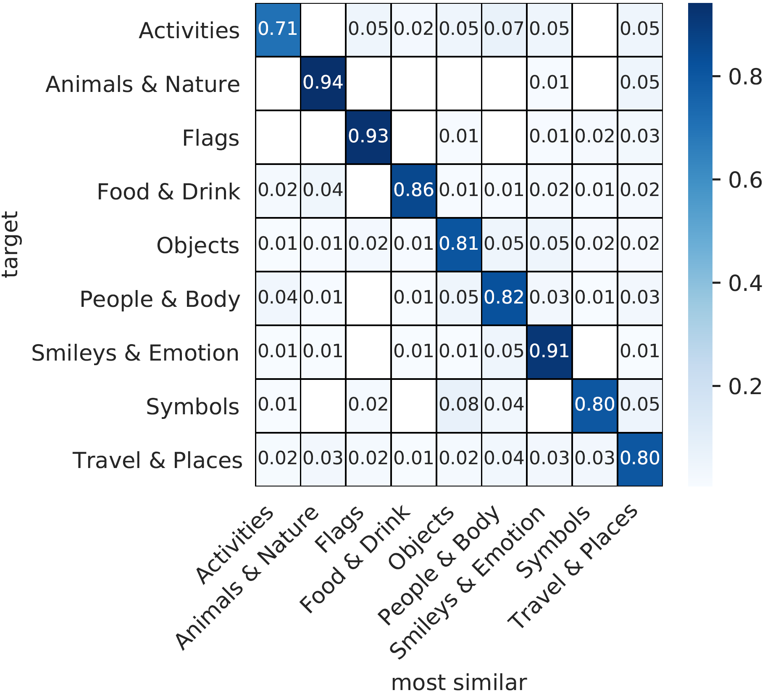
Emoji 2 Emoji – Top 1 Emoji Group Confusion
Top 1 similar emoji
usually within same group
prediction
Notes:
Generally, a good mapping within the given Emoji Groups.

Slide 14
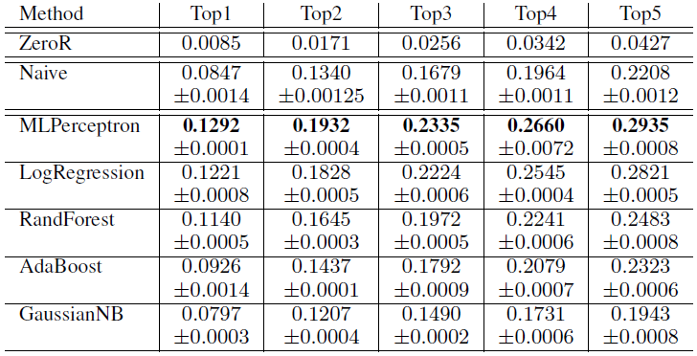
Text 2 Emoji - ML Results
Predict first emoji (1 out of 117)
Naive Approach: Most similar within embedding
Other off the shelf ML Tools
Better than random
Comparably well to RW

