Slide 1





Interpreting
Emoji with Emoji
$$⟹$$
Jens Helge Reelfs¹, Timon Mohaupt ², Sandipan Sikdar ³, Markus Strohmaier ⁴,
and Oliver Hohlfeld ¹
¹ Brandenburg University of Technology
² Talentschmiede Unternehmensberatung AG
³ RWTH Aachen University
⁴ University of Mannheim, GESIS, CSH Vienna
July 14, 2022
International Workshop on Emoji
Understanding and Applications in Social Media
Notes:
Hello & Welcome.
In the next 15 minutes,
we are going to talk about
Interpretable Embeddings
- pecifically wrt Emoji
I am Helge, Researcher & PhD Student at BTU
– and this is joint work with Timon, Sandipan, Markus & Oliver.
Thanks
For having me here once again
Thanks to the chairs for organizing the workshop
And thanks to the Reviewers for their feedback
Let‘s get right into it & start with a short Motivation
(#)

Slide 2
Motivation
Word Embeddings make text machine-understandable
Usually trained on word co-occurrence
  Excludes wider Contexts – classical Word Embeddings
Used within a plethora of downstream tasks
Desire/Need for X-AI
How to make Embeddings interpretable?
How well does it work? (wrt human judgement)
Notes:
So, word embeddings make text machine-understandable
by putting them into a vector space
(#) Almost 10 years ago,
Mikolov et al proposed using
word co-occurence
as optimization function in the W2V paper
-> classical word embedding
(#) Though they disregard textual context
in a wider sense
proven being efficient
-> thus used in lots of downstream tasks
(#) Further, within recent years, we have seen
the rise of Explainable AI
eg Providing guarantees,
but in our regime for better
understanding
-> understanding algorithms
-> new cues for further evaluation
„learning from the model“
(#) We ask the question:
How to make Embeddings Interpretable
(#) How well does this work
– wrt Human Judgement

Slide 3
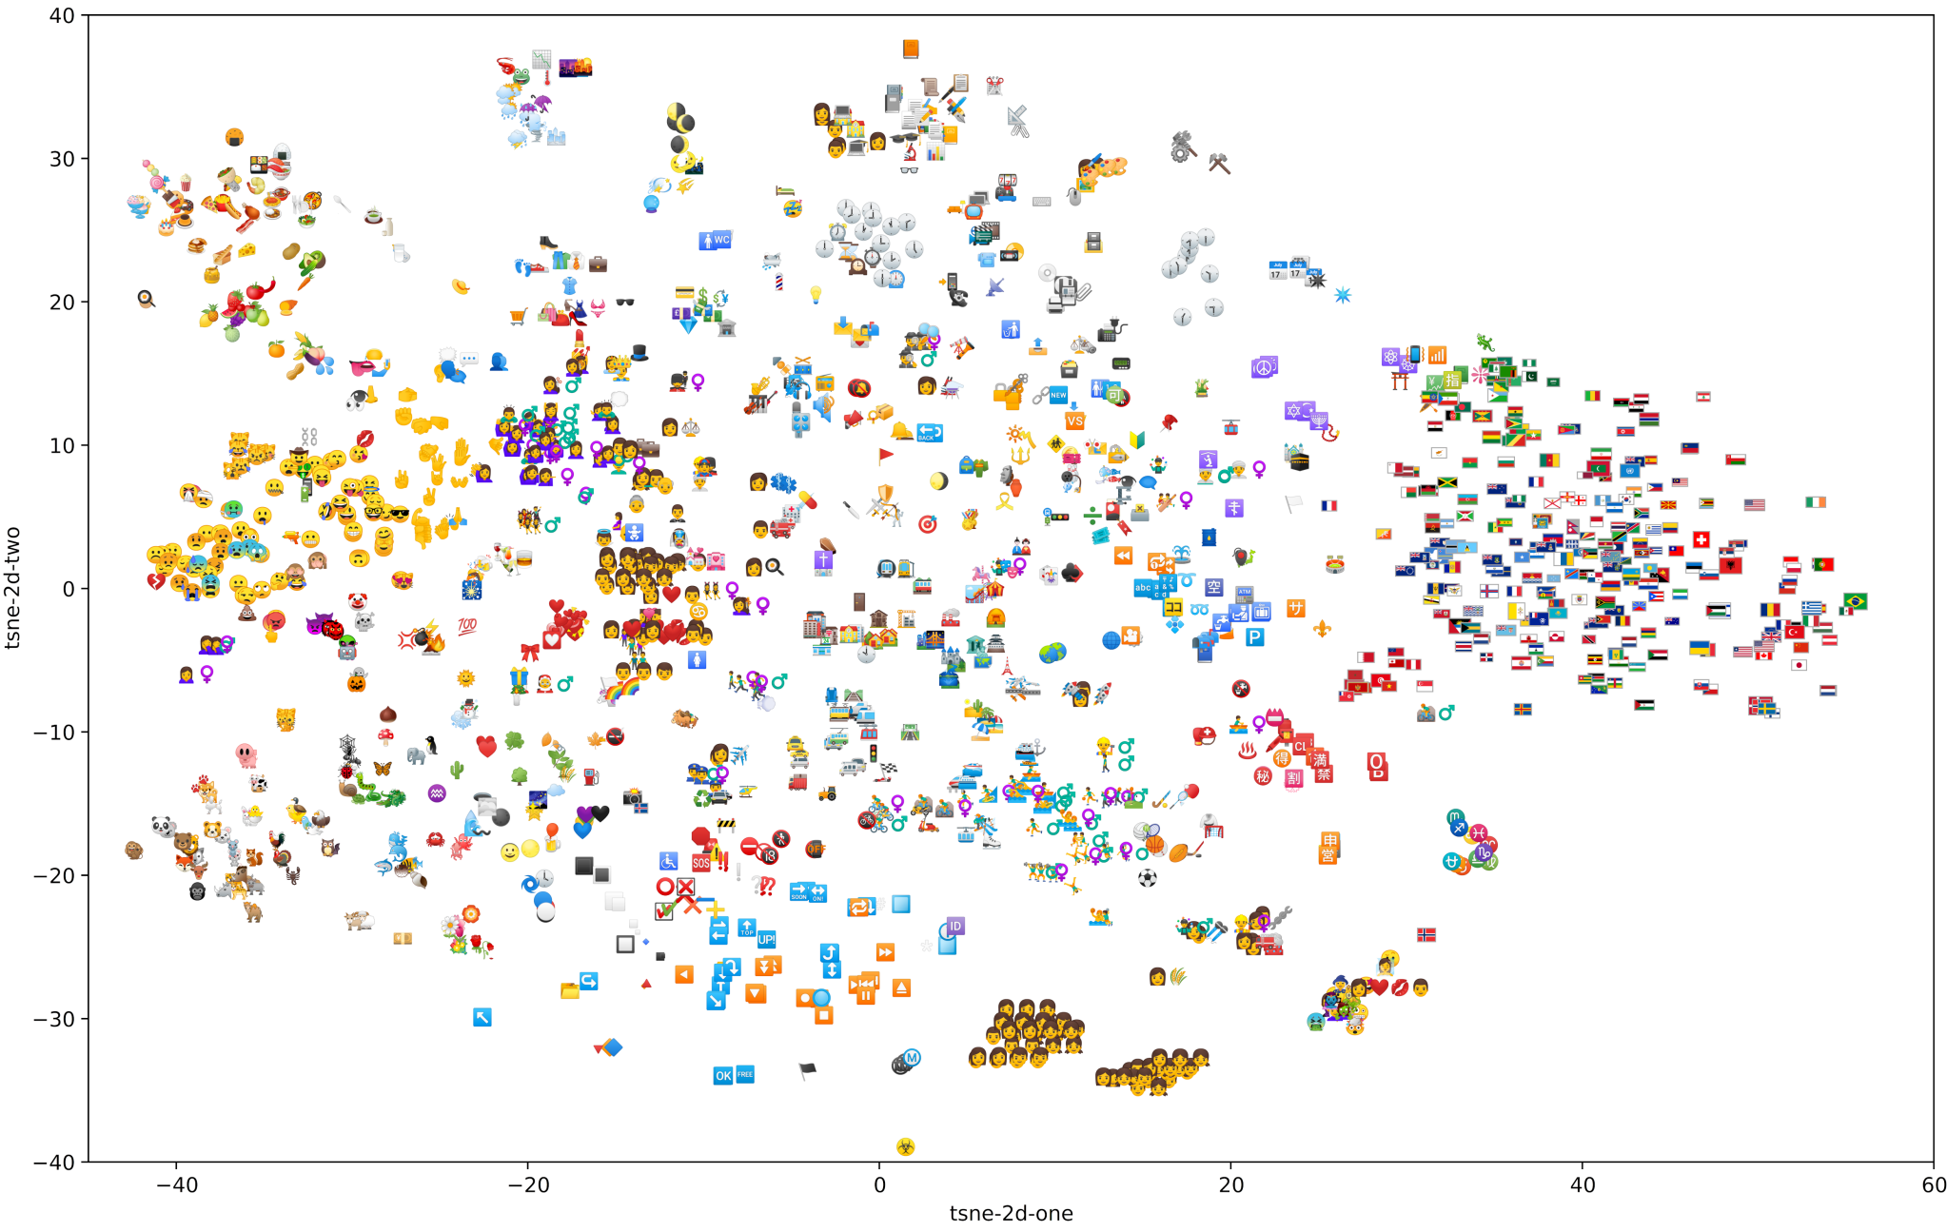
Word-Emoji
Embedding
Captures semantics well [1]
Notes:
Lets see how such Embeddings look like
(#) TSNE-projection
of only emoji
(#) We find clusters from
Animals
to Emotions
& Edibles
(#) Over Sports
to Fun with Flags
just as an example.
there are lots
more subtle constellations
Albeit diregarding context
(#) Captures semantics well.
Simplicity can be sexy.

Slide 4


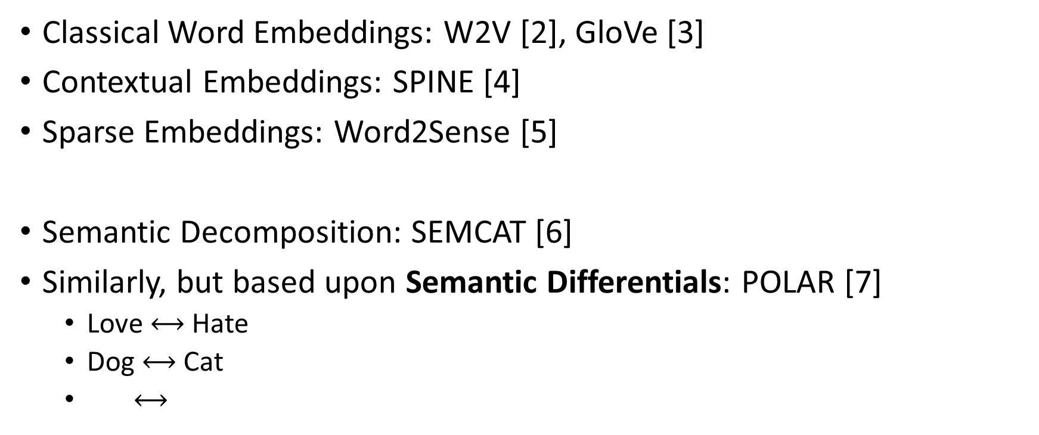
Related Work
Classical Word Embeddings: W2V [2], GloVe [3]
Contextual Embeddings: SPINE [4]
Sparse Embeddings: Word2Sense [5]
Semantic Decomposition: SEMCAT [6]
Similarly, but based upon Semantic Differentials: POLAR [7]
  Love $⟷$ Hate
  Dog $⟷$ Cat
  $⟷$
Notes:
As for Classical Word Embeddings,
famous Word2Vec and GloVe
(#) Others contextual embeddings
denoising autoencoders enforcing sparsity
(#) Or Sparse Embeddings –
Unsupervised modeling of „senses“
via generative LDA process
Or more traditionally,
deduct meaning for latent variables by
linear probing/activation flow
(#) The SEMCAT authors use
learned Semantic Decompositions
(#) However, most of these techniques
are pretty expensive and sort of advanced.
Similarly to the decomposition, the
POLAR framework allows
simple transformations
The neat idea is to leverage
Semantic Differentials
as found in psychology.
The easiest case are polar opposites like..
Love – Hate, Cat – Dog, or Sun – Ice
Complies with classical word embeddings
though we only need to locate concepts
within the embedding space to make this work
We leverage embedded words
& thus embedding structure
Result: classical word embedding again,
BUT with semantic structure
according to the differentials
along the dimensions
No worries:
I will tell you how this works in a couple of slides

Slide 5
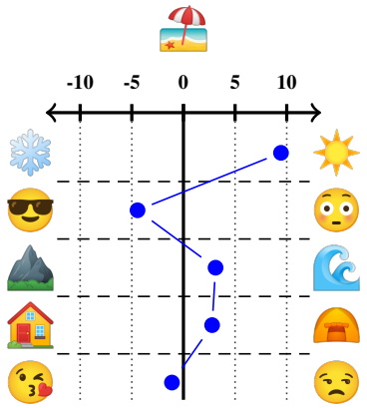
Goal & Approach
Create Interpretable POLAR Embedding
Evaluate Algorithm Interpretability wrt Human Judgement
Specifically focus on Emoji
  Easy to grasp
  Rich in Expressiveness beyond Words
Provides basis for embedding comparisons
Might enable cross-platform emoji usage disambiguation
Notes:
But let‘s discuss our Goal & Approach first.
We use POLAR as a tool to
create interpretable embedding
(#) I will show you the result for the
example „Beach with Umbrella“ Emoji
(#) Our interpretable embedding
consists of dimensions representing
a differential on a scale.
(#) Encoded Terms gets assigned
a value for each of these dimensions.
(#) Then, we analyze algorithm results
with humans in the loop:
Does the Algo select correct
(best) differentials?
... And for the correct reason?
(#) We focus Emoji
easy to grasp
and may provide
expressiveness beyond words
(#) Down the line,
might enable
inter-embedding comparisons
on a normed basis
Further, as has been shown,
not all emoji are used equally
(eg cultural differences)
emoji usage disambiguation
across usergroups

Slide 6
















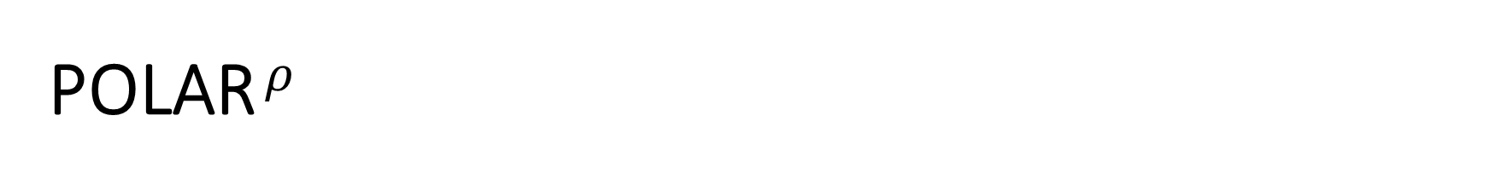
POLAR $ρ$
Interpretable
Scale
Differentials
Projection
0
( - )
( - )
0
( - )
( - )
( - )
0
...
Notes:
So the basic Idea is:
for selected differentials
carry word-cooccurrence semantics
over into
(otherwise meaningless)
embedding dimensions.
(#) First, we start with
Differentials providing
Semantics
(#) Starting out with a single differential
as an example
we have our embedding
and an embedded object
to be made interpretable
(#) Next we take the
differential „Sun“-“Ice“
(emoji analogy to hot-cold).
We define their differential as a
hyperplane through the embedding space
(dashed red vector)
(#) Then, we do an orthognal projection
from the object
onto this hyperplane
determining a shortest distance.
(#) as shown with the (blue vector).
We obtain an interpretable scale value
between both opposites via
the length of the adjacent leg
of the projection (green vector).
(#) = scale measure
of umbrella-beach emoji for this differential
(#) We repeat this for all differentials
as idicated with
Mountain / Seawave
(#) Smiling Face w Sunglasses / Flushed Face
Note: This is primarily a cheap dot product operation for each term + dimension.

Slide 7
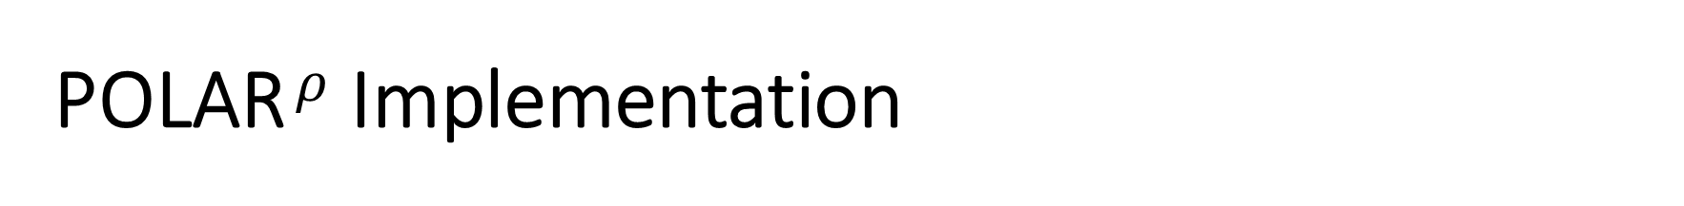
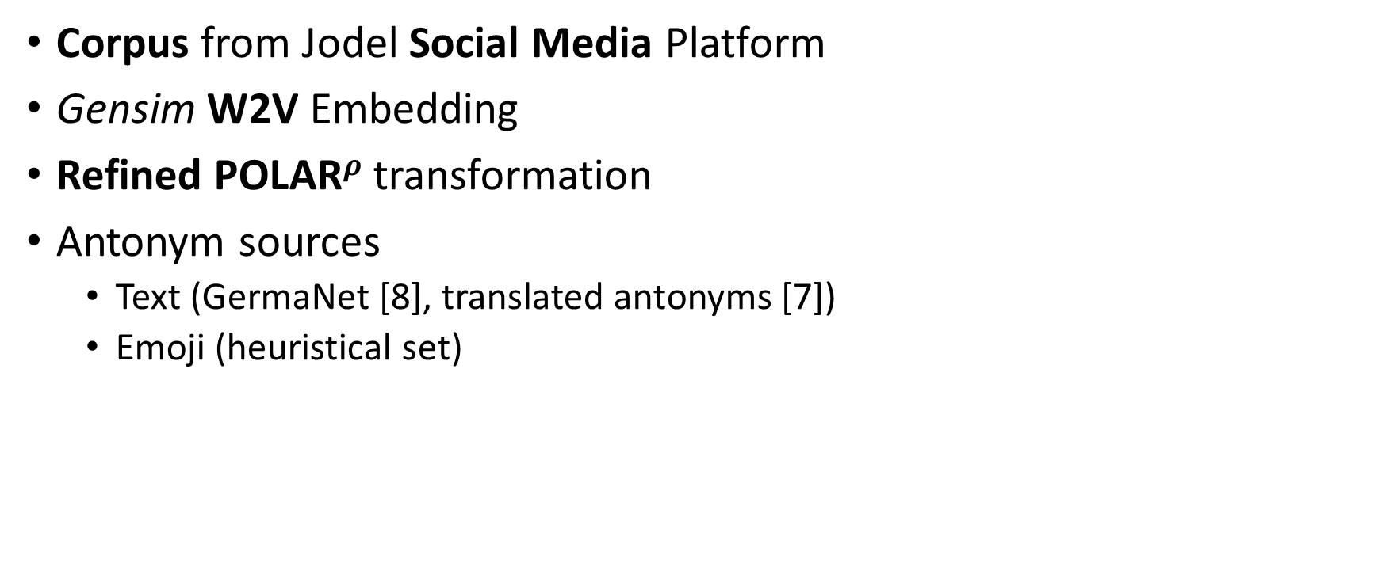
POLAR $ρ$ Implementation
Corpus from Jodel Social Media Platform
Gensim W2V Embedding
Refined POLAR$ρ$ transformation
Antonym sources
  Text (GermaNet [8], translated antonyms [7])
  Emoji (heuristical set)
Notes:
We used a Social Media corpus
from the Jodel Application
in Germany 2014-2017
with about 50M posts
20% of them using emoji
(#) We created a vanilla
gensim W2V embedding
(#) & used our refined POLAR Projection
as shown before
(#) The key point here is
how to choose differentials
– need to be supplied externally.
As for Text,
we used GermaNet
+ translated lists original POLAR paper
also tried WordNet/OdeNet
– however, antonym-synsets are too broad
& thus often do note make sense
(#) As for Emoji,
in lack of alternatives,
we heuristic set
~40 differentials - PoC.
Note:
We could have created
endless combinations of facial emoji,
we opted for a broad set.

Slide 8
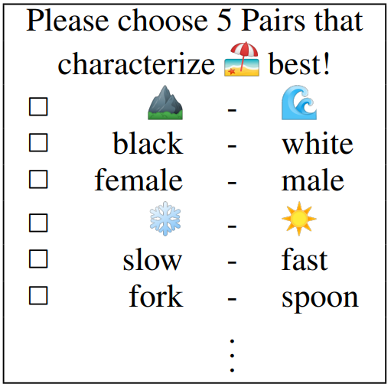
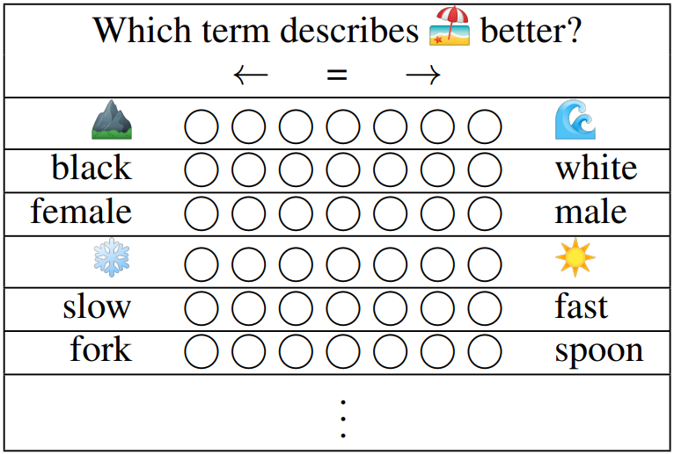
Study Design
Selection Test
Preference Test
Notes:
Next, our study design includes two tests
(#) Selection Test
„Please choose 5 Paris that characterize
Beach-Umbrella Emoji best!“
Word Intrusion
Find out whether the
algo identifies
best interpretable dimensions
Top5 vs random bottom 50%
(#) Preference Test
„Which term describes
Beach-Umbrella Emoji better?“
Find out whether
algo measures the direction
of meaning between opposites correctly
That means:
Does the algo
select for the correct reason?
Again: Top5 vs random bottom 50%
We employ a 7p scale
– incl. Equality/nonequality;
we normalize scale usage in our eval
Having sorted out our questions,
we next need to define study cases next.

Slide 9
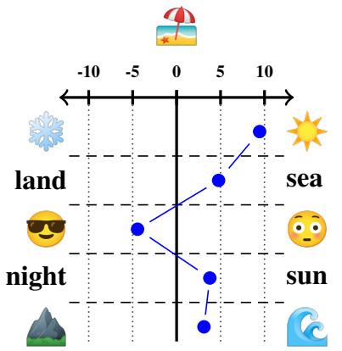
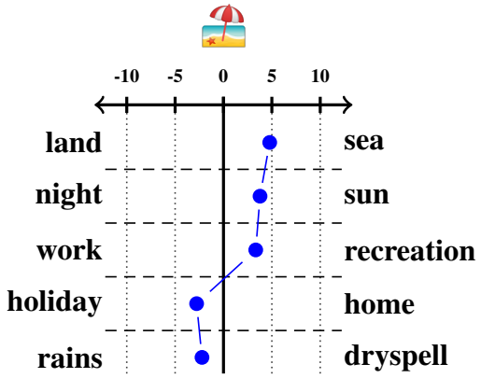
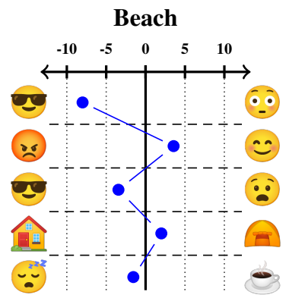
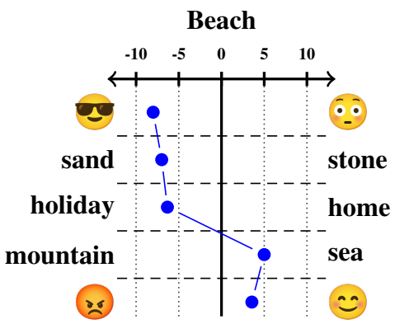
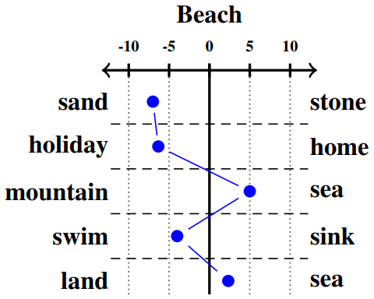
Study Campaigns
Emoji
Emoji & Words
Words
with
Emoji
Words
Notes:
As we have seen in previous examples,
Interpreting Emoji with Emoji is one alternative.
However, having words,
we can also interpret
(#) emoji with
words+emoji mixed
(#) Or even only words
Further, we can
likewise interpret words with
(#) Wods only,
Mixed
Or Emoji only
Which leads us to 6 campagins total.

Slide 10
Study Implementation
Micoworkers Platform
Intances
  6 Campaigns
  50 words + 50 emoji
  Bundled into 5 tasks each 10 emoji/words
  Selection + Preference Test
QA Measures
  Handcrafted test questions (non-trivial!)
  1 test in Selection + Prefernce Test each
  Thresholded acceptance 4/5 correct answers
Notes:
As for the actual implementation,
We used the Microworkers platform
(alike Amazon Mechanical Turk)
Compensation estimated
above German minimum wage
(#) In summary, we end up with
6 Campagins
A total selection of 50 emoji + 50 words
We bundle them
5 tasks with 10 emoji/words each
All with both: Selection & Preference Test
(#) Due to untrusted annotators,
need Quality Assurance measures.
We thus handcrafted test questions
not trivial.
Should not be too obvious, but unambiguous.
1 test question into each block.
threshold for acceptance at 80%
however, most answers we fine.
Long story short:
lots of preparation + careful design.
and campagins
Next stop: Our main Evaluation Results.

Slide 11
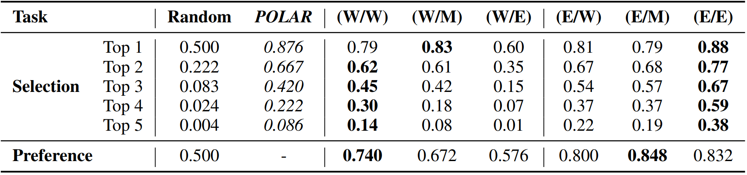




Results
baselines
6 study cases
POLAR
works well*
Words – Words/Mixed
Words –
Emoji
Emoji
Selection
Words – Words/Mixed
Words –
Emoji
Emoji
Preference
Notes:
(#) Remember, we have two different tasks:
(#) Selection:
whether POLAR selects suitable dimensions
(#) Preference:
whether POLAR assigns correct meaning
(#) As a baseline,
random
original POLAR results
(different embedding, different antonyms)
(#) POLAR quite well
in the TOP1 selection:
POLAR‘s choice was
87.6% of the time
in line with human judgement
measure decays incoporating more dimensions
(#) Next, Let‘s look into our Study Results
by Application & test.
(#) Interpreting
Words with Words
or Words+Emoji works very well
(#) However, words with emoji
NO statisfactory results
(#) Across the board,
interpreting Emoji with Words or Emoji
does pretty good
(#) dimension selection does its job,
We wanted to know
if it does for the correct reason
in the Preference test.
(#) Words with words or words+emoji
good and ok-ish
yet emoji fail to describe wods.
(#) scale measures for emoji are at the upper end
You migh ask WHY?
This is yet unknown.
presume that the
expressive space of emoji is insufficient
to generally describe words.
NOT seen for emoji/emoji
However, in combination with words,
emoji might add valuable expressiveness.

Slide 12



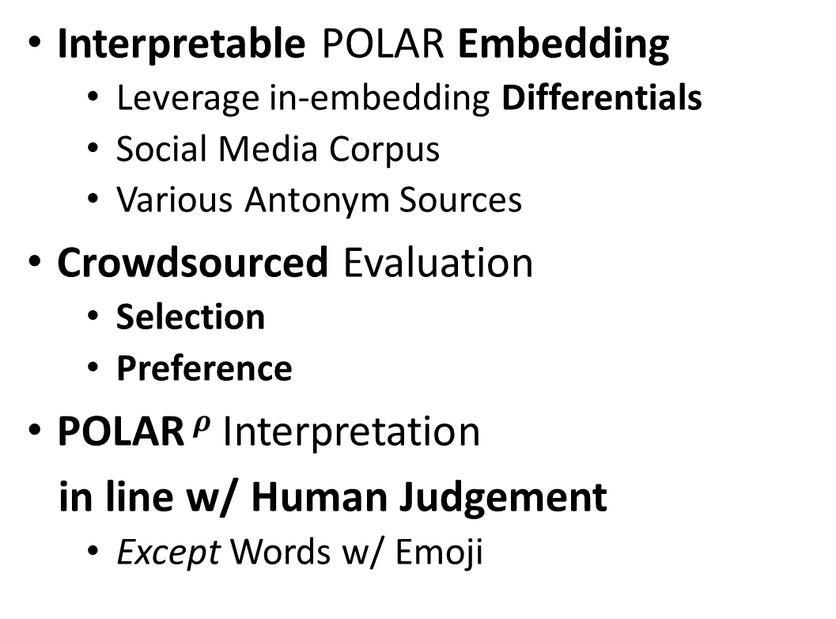
Summary
Interpretable POLAR Embedding
  Leverage in-embedding Differentials
  Social Media Corpus
  Various Antonym Sources
Crowdsourced Evaluation
  Selection
  Preference
POLAR $ρ$ Interpretation
in line w/ Human Judgement
  Except Words w/ Emoji
Interpretable
Embedding
Crowdsourcing
Evaluation
Notes:
In Summary, what have we done...
(#) interpretable embedding
refined POLAR projection method
Leveraging semantic differentials
of words and emoji
(#) crowdsourced evaluation
According to human judgement(!)
whether POLAR
(#) identifies suitable dimensions
(#) and whether POLAR does this
for the correct reason
(#) We find that POLAR works well
in Selection + Preference
almost all cases
Except for interpreting words with emoji only.

Slide 13


Check out the paper for more!
... now it is time for discussions.
https://h.reelfs.de
Notes:
I hope you enjoyed this talk
You will find more details in our paper.
if interested in this topic, checkout my website as well
Thanks.
Now it is time for your questions and ideas!

Slide 14
References
[1] „Word-Emoji Embeddings from large scale Messaging Data reflect real-world Semantic Associations of Expressive Icons“, Reelfs et al., 2019, EMOJI
[2] „Distributed representations of words and phrases and their compositionality“, Mikolov et al., 2013, NeurIPS
[3] „Glove: Global vectors for word representation“, Pennington et al., 2014, EMNLP
[4] „Spine: Sparse interpretable neural embeddings “, Subrmanian et al, 2018, AAAI
[5] „Word2sense: sparse interpretable word embeddings“, Panigrahi et al, 2019, ACL
[6] „Semantic Structure and Interpretability of Word Embeddings “, Senel et al., 2018, IEEE/ACM Transactions on Audio, Speech, and Language Processing
[7] „The POLAR Framework: Polar Opposites Enable Interpretability of Pre-Trained Word Embeddings “, Mathew et al., 2020, WWW
[8] „GermaNet – a lexical-semantic net for German “, Hamp et al., 1997, Automatic Information Extraction and Building of Lexical Semantic
Resources for NLP Applications

Slide 15
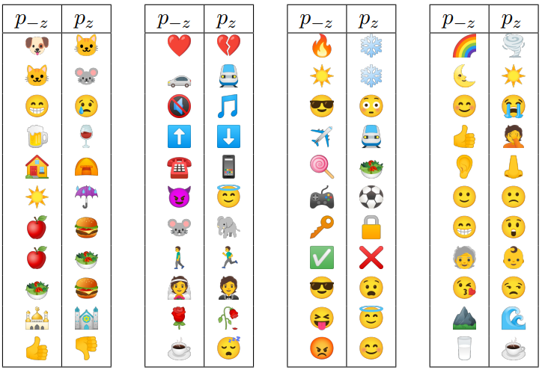
Emoji Antonyms

Slide 16
Approach
Interpretable
Embedding
Crowdsourcing
Evaluation

