Slide 1

Hashtag Usage in a Geopgraphically-Local Microblogging App
Helge Reelfs
San Francisco, CA, 13th May 2019

Slide 2
Motivation

Slide 3
Hashtag Usage
Why Hashtags?
Actual question how does information spread within a network?
Hashtags may be used as a proxy for information
Didn’t others already investigate on that? – Sure.
Lots of contagion/epidemic modelling
Lots of work on, e.g., Twitter

Slide 4
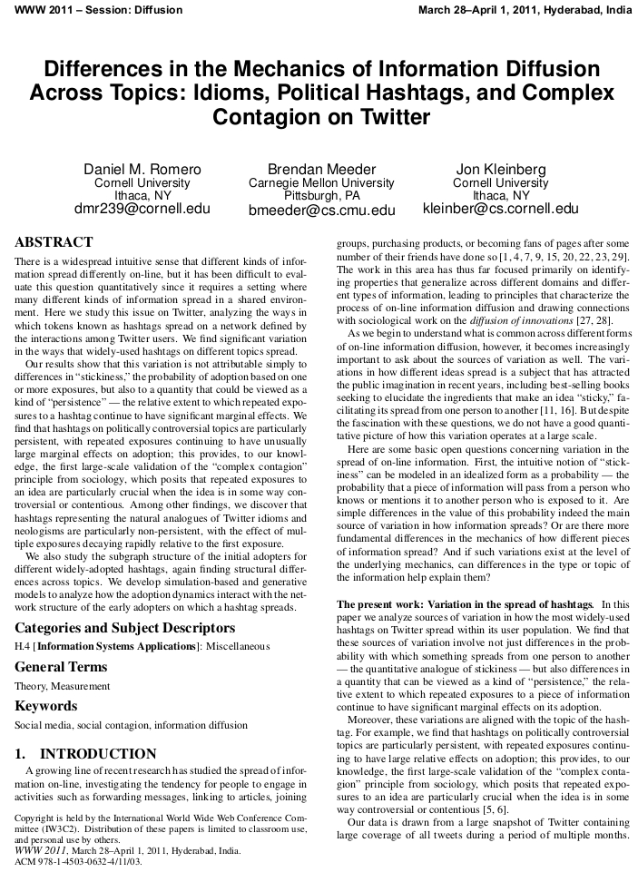
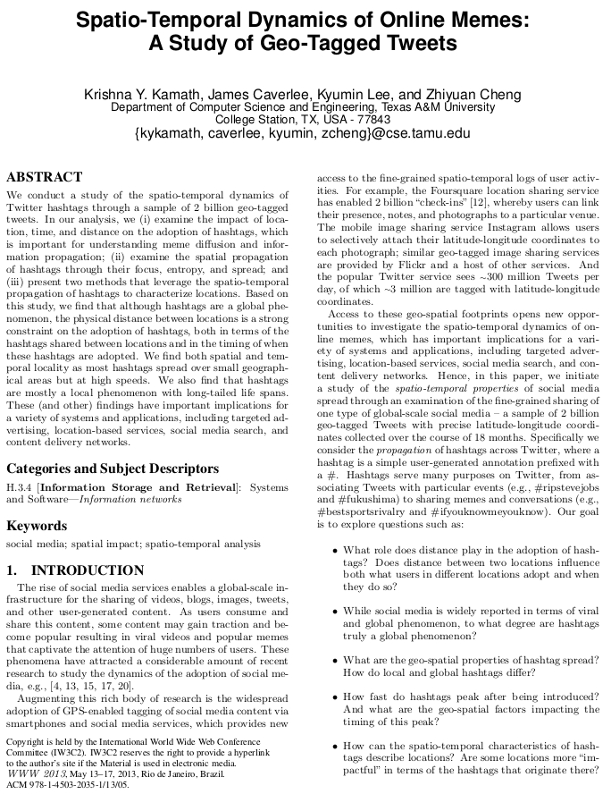
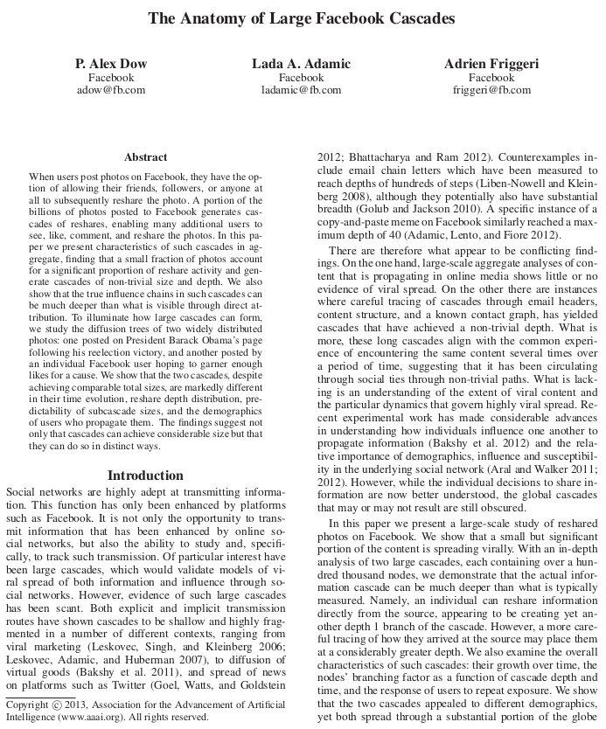
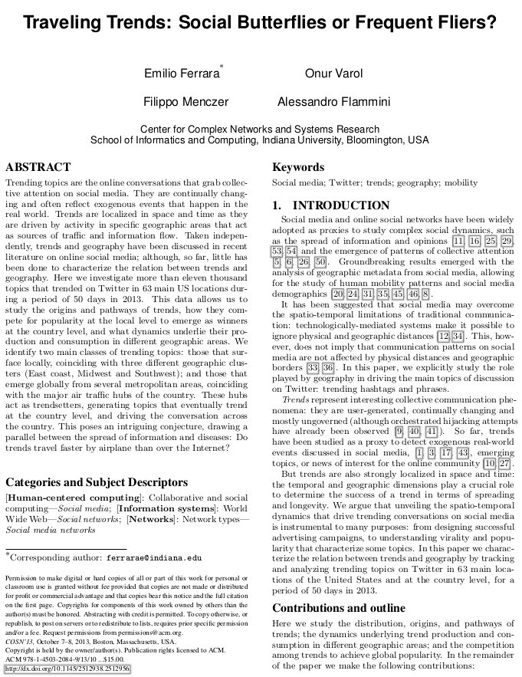
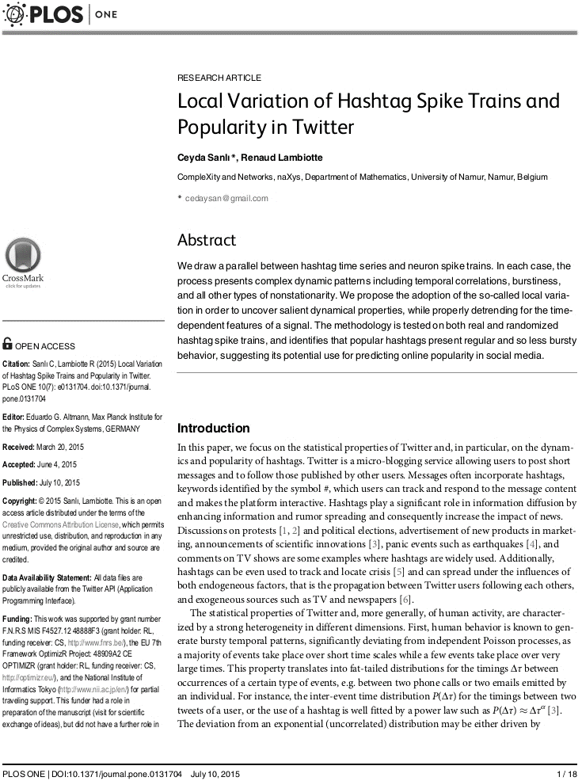
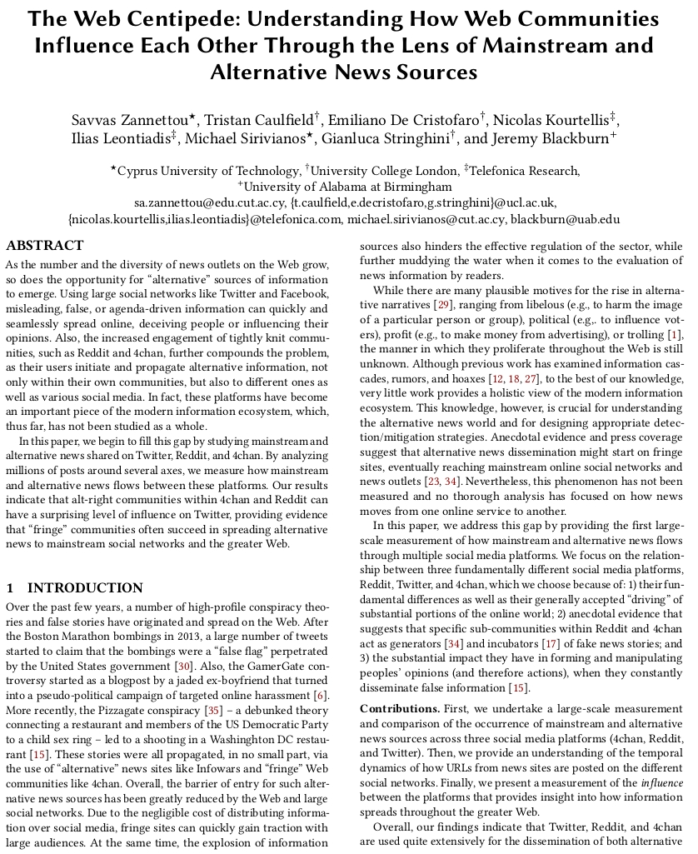
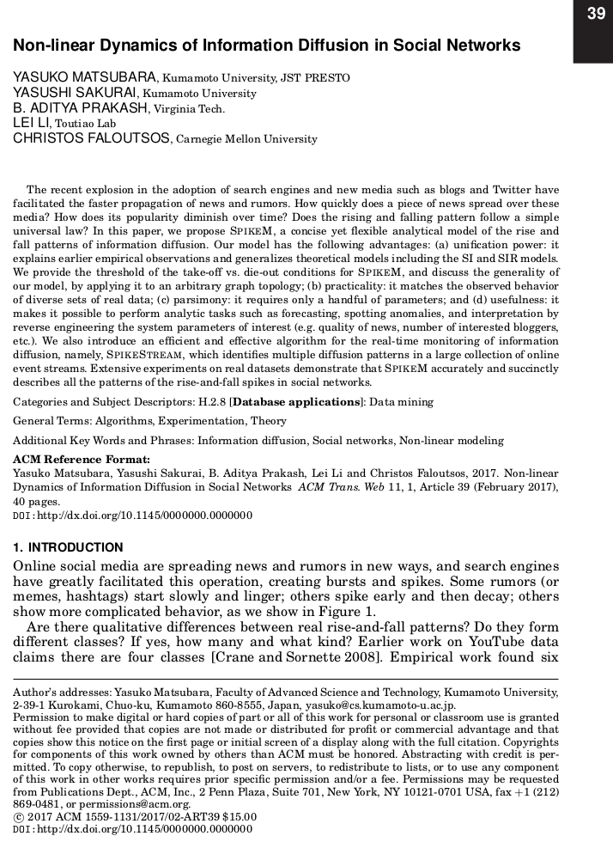
Hashtag Usage

Slide 5

Hashtag Usage
Why Hashtags?
Actual question how does information spread within a network?
Hashtags may be used as a proxy for information
Didn’t others already investigate on that? – Sure.
Lots of contagion/epidemic modelling
Lots of work on e.g., Twitter
Why then do the same Jodel?
Jodel combines unique design decisions/features
Location-based
Anonymous
How does information spread in this different setting?

Slide 6

But wait, Jodel – never heard of it…

Slide 7
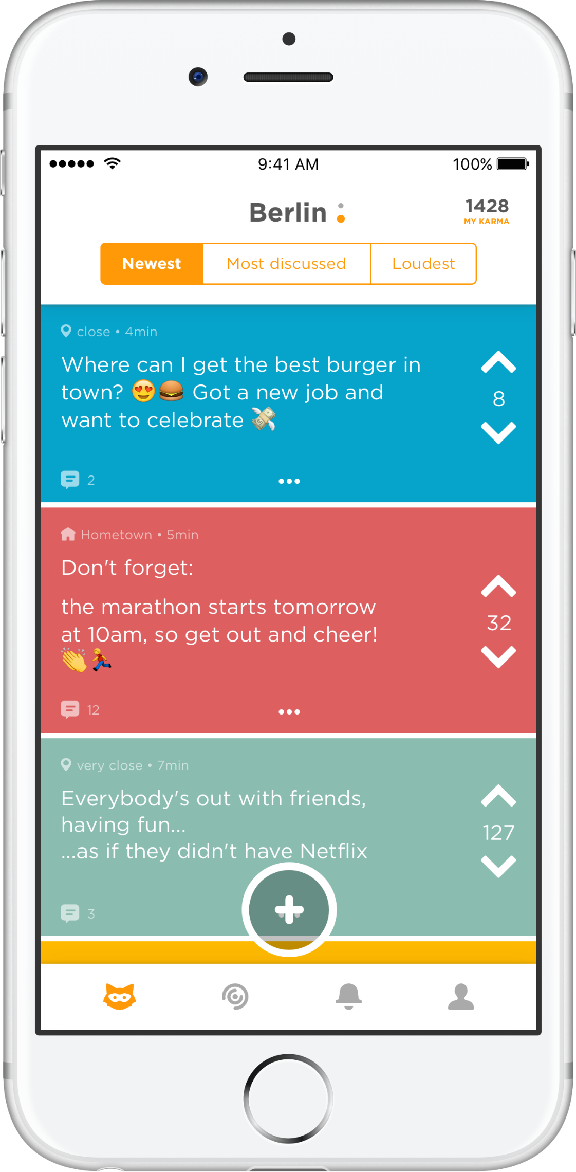
Jodel
Microblogging/Chatting App
Text
Images
(Short videos)
Creating local communities
No user profiles
Specific channels
@TheWebConference
Set out in Germany late 2014
Popular across Europe & Gulf states
Mostly Students & Pupils

Slide 8
Jodel
Community
Feed
a “Jodel”
(thread)
Up-/Downvote
& “Karma”

Slide 9
Used Dataset
Ground-truth information from operator
German speaking countries only
10/2014 until 08/2017
Annotated location information with city
Simple Hashtag extraction: [\w\däöüÄÖÜß\.\-_]+
Hashtag Uses | 41 M | # occurrences
Hashtags | 13 M | # distinct hashtags
 | 12 M | # hashtags used once
Messages | 27 M | # messages w. hashtags
Users | 1.2 M | # users posting hashtags
Locations | 6.8 k | # distinct locations

Slide 10
Birds-Eye View

Slide 11
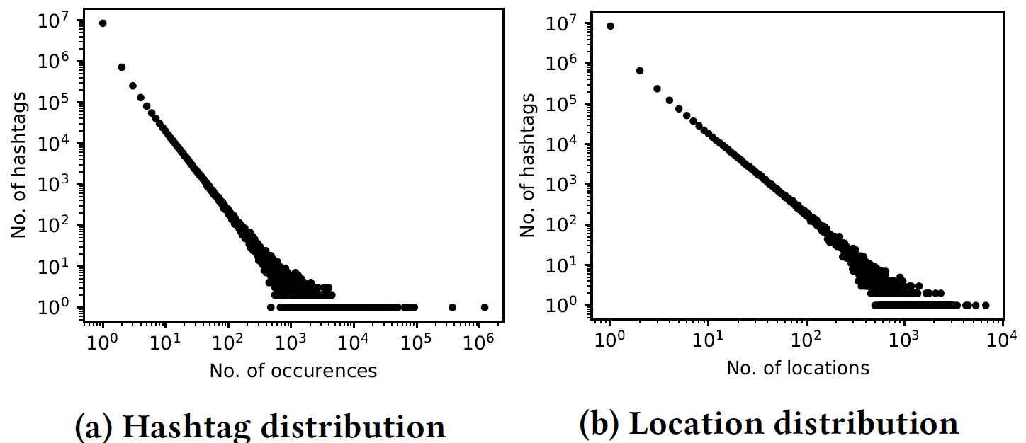
General Statistics
* Similar to Twitter.

Slide 12

Used Metrics
Related Work – Kamath et. al
Spatial Focus – Probability of most popular City
Spatial Spread – avg dist to weighted geographic center
Spatial Entropy – number of involved cities
WWW’13

Slide 13
Used Metrics
Related Work – Kamath et. al
Spatial Focus – Probability of most popular City
Spatial Spread – avg dist to weighted geographic center
Spatial Entropy – number of involved cities
Our adaption to time for our longitudinal dataset
Temporal Focus – Probability of most popular day
Temporal Spread – avg dist to weighted time center
Temporal Entropy – number of involved days

Slide 14
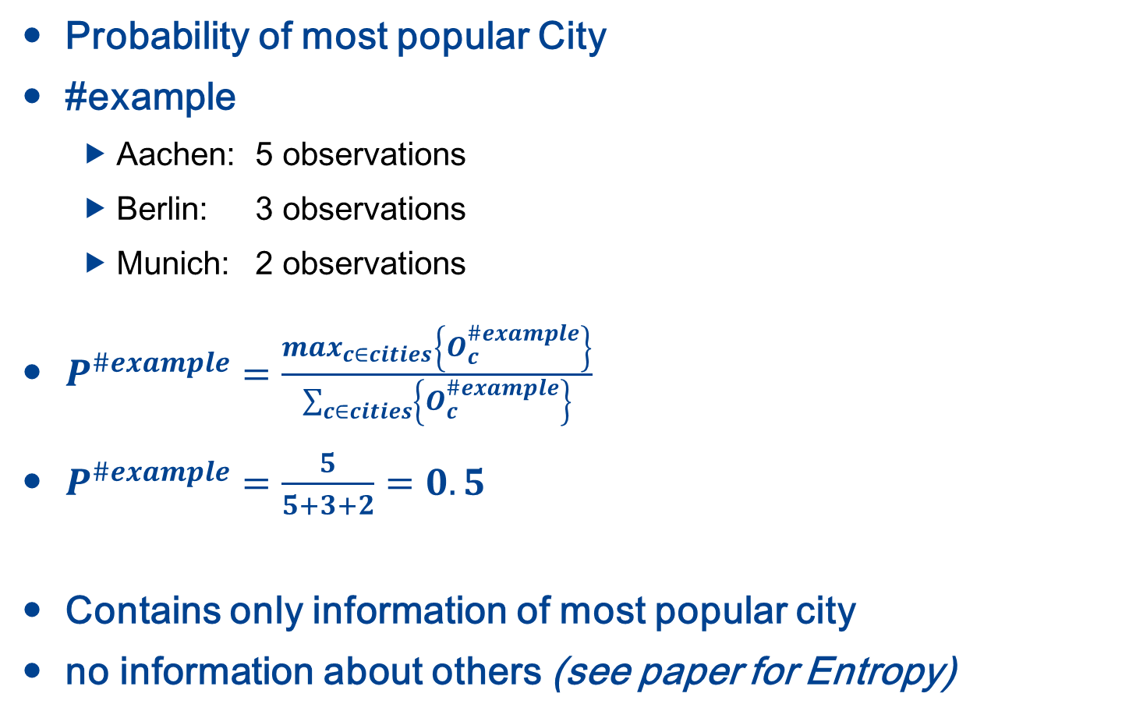
Spatial Focus - Explained
Probability of most popular City
#example
Aachen: 5 observations
Berlin: 3 observations
Munich: 2 observations
$P^{\#example}=\frac{max_{c∈cities}\left\{O_{c}^{\#example}\right\}}{\sum_{c∈cities}{\left\{O_{c}^{\#example}\right\}}}$
$P^{\#example}=\frac{5}{5+3+2}=0.5$
Contains only information of most popular city
no information about others (see paper for Entropy)

Slide 15
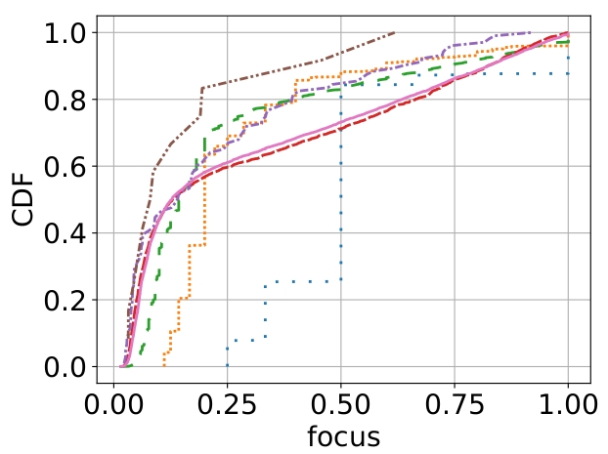
Spatial Focus - Expectation

Slide 16
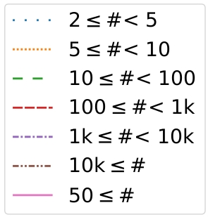
Spatial Focus - Results
Less popular Jodel hashtags are less focused
Unlike the expectation from being location-based!

Slide 17
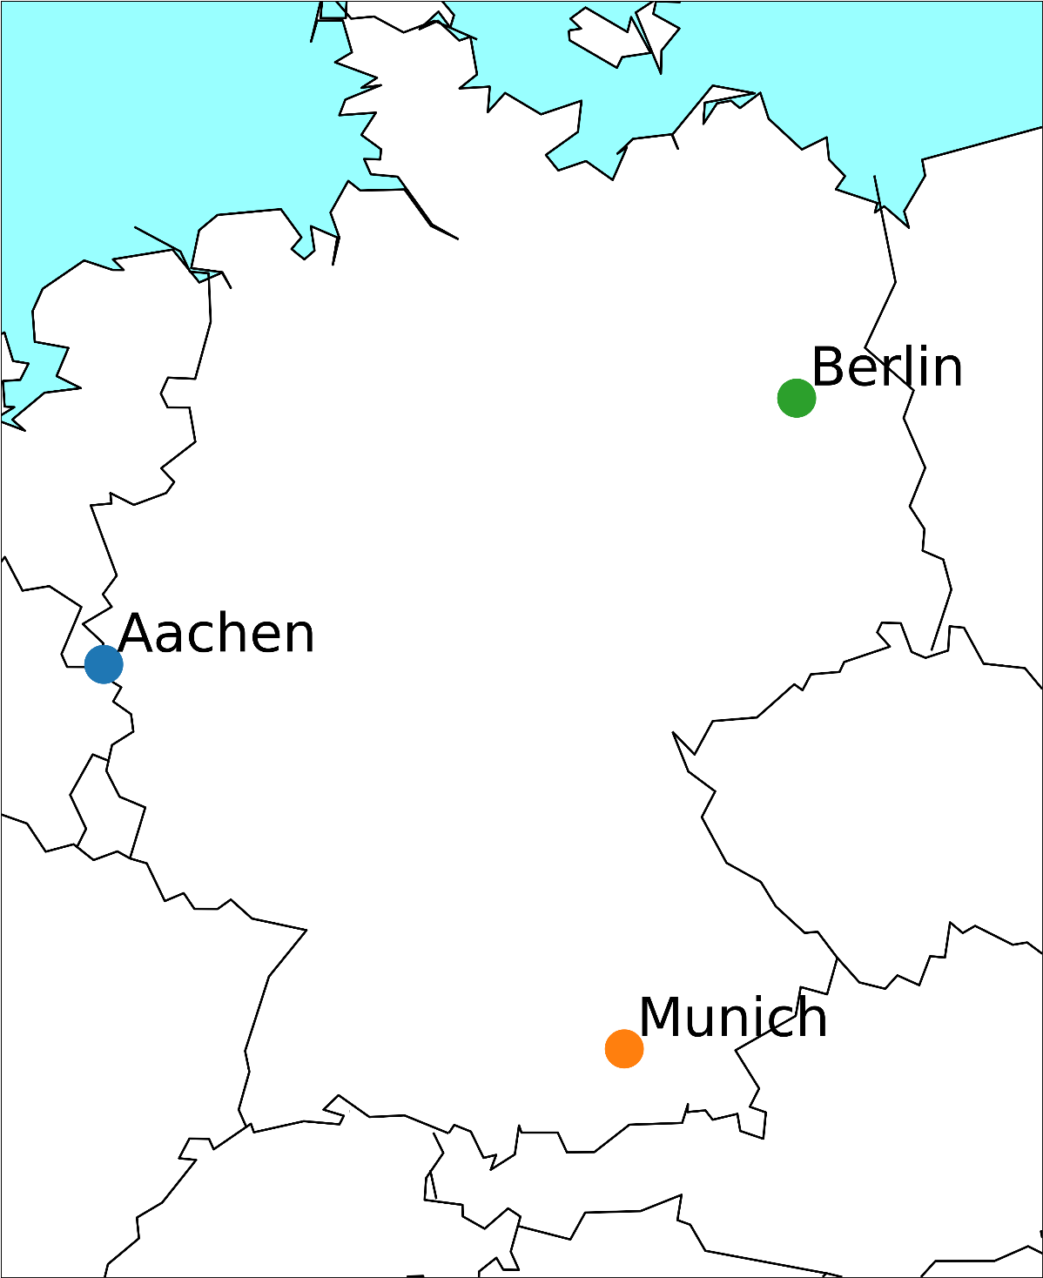
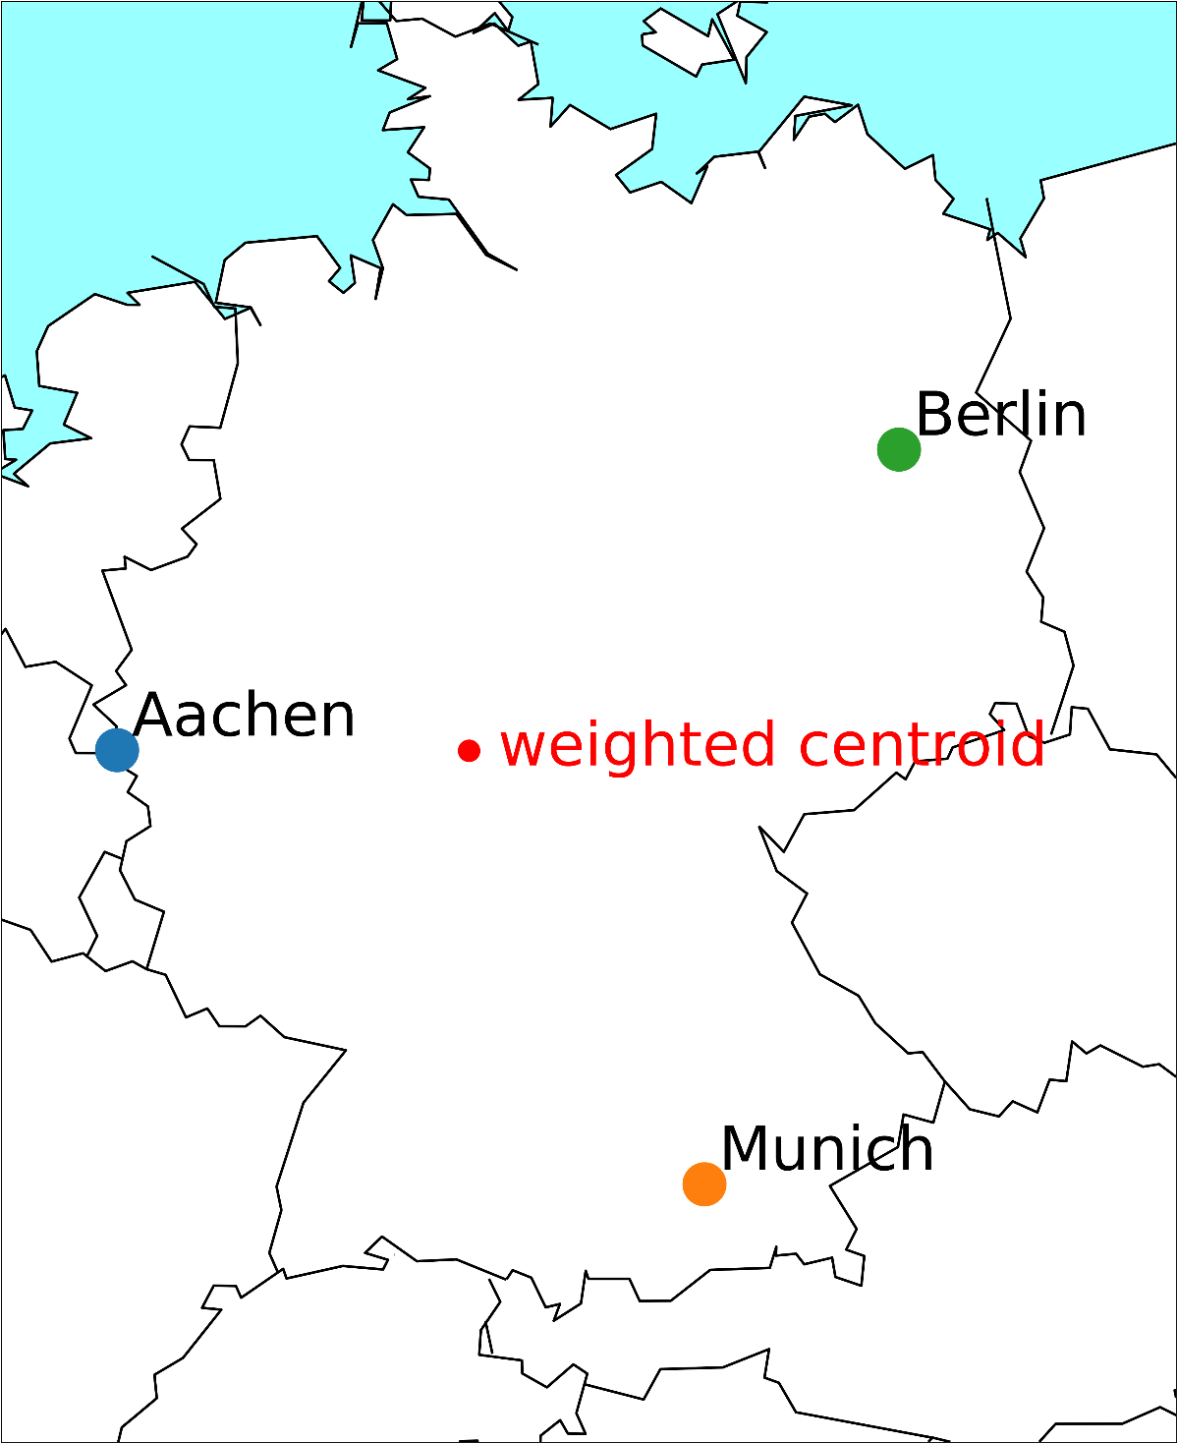
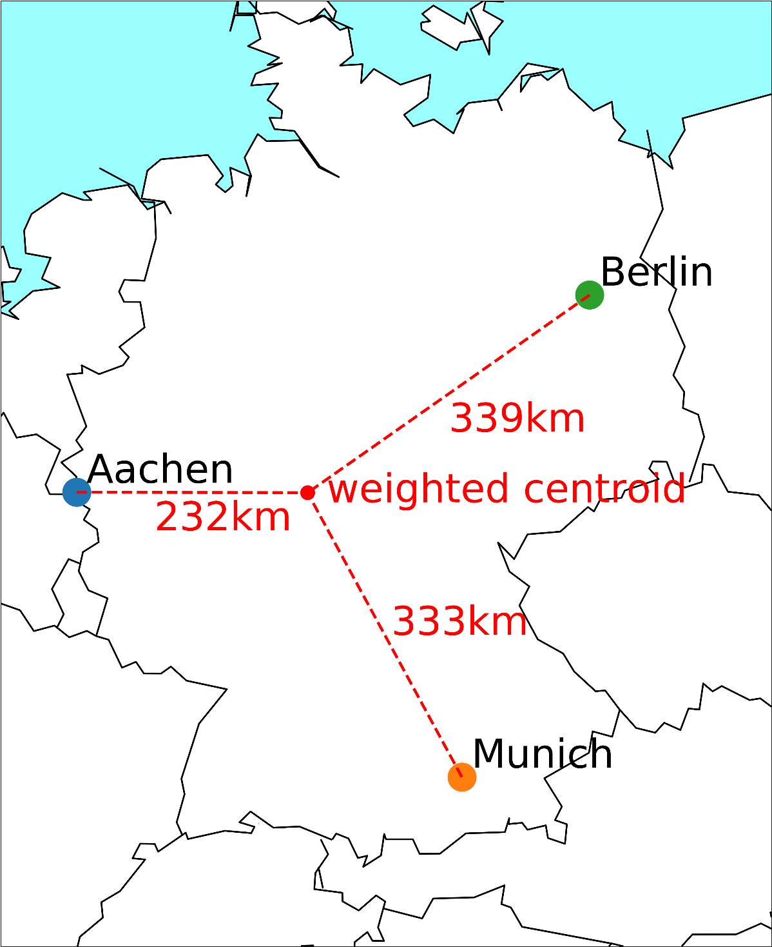

Spatial Spread - Explained
Average geographic expansion
#example
Aachen: 5 observations
Berlin: 3 observations
Munich: 2 observations
Calculate weighted centroid
Calculate average distance
$S^{\#example}=\frac{1}{|O^{\#example}|}\sum_{c∈cities}^{\#example}{{dist}_{c}^{centroid}∗O_{c}^{\#example}}$
$S^{\#example}=\frac{1}{10}∗\left(5∗232+3∗339+2∗333 \right)km≈284km$

Slide 18
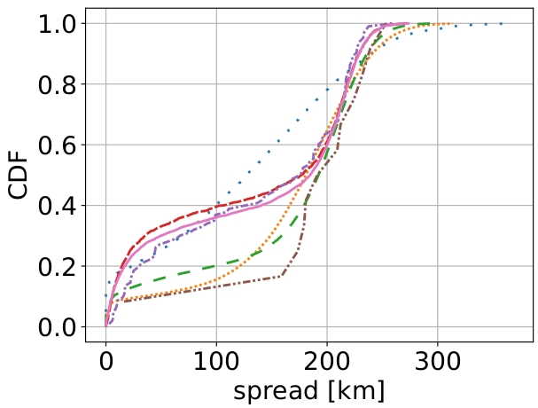
Spatial Spread - Expectation

Slide 19
Spatial Spread - Results
Non-top, but popular Hashtags are more local on Jodel!
Jodel caps at 250km (~diameter popular cities Germany)

Slide 20
Temporal Metrics

Slide 21
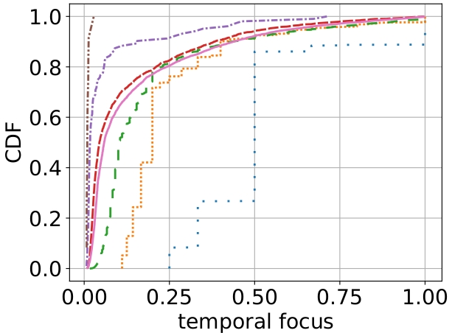
Temporal Focus - Results
Temporally rather unfocused
Focus decreases with popularity

Slide 22
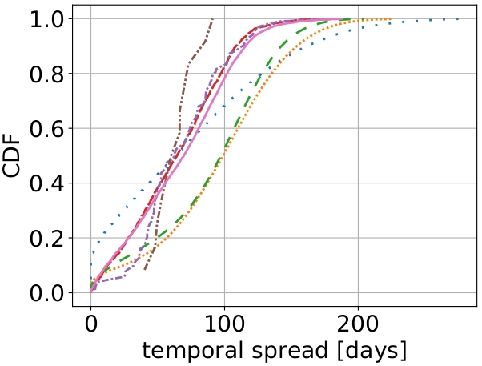
Temporal Spread - Results
Rather linear behavior at different slopes
Especially less popular hashtags occur randomly

Slide 23

Diving Deeper
…. aka making more sense out of it

Slide 24
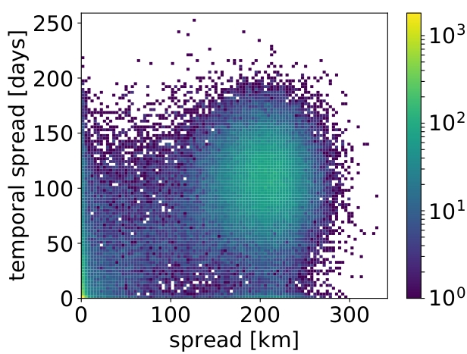

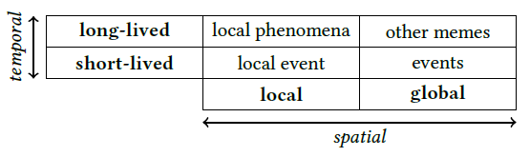
Temporal vs. Spatial Spread

Slide 25
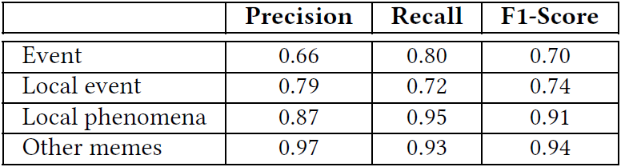
Classification via ML methods
450 most popular Jodel manually classified
Lots of features (presented ones and more, cf. Paper)
10-fold cross-validation
Applied different statistical methods
KNN, Classification & Regression Trees, Naive Bayes, Logistic Regression, LDA
LDA Best Performer

Slide 26
Conclusion
Jodel is not as local as one might expect
Yet, there are local Hahstags
We can statistically classify their type
Big cities share most popular hashtags
Temporal & Spatial metrics
Hashtags likely spread via bigger communities
Hashtags likely diffuse into smaller neighbouring communities
There is more to investigate...
Advanced and better ML!
Who drives hashtag adoption?
Can me model the adoption?

Slide 27
Thanks.
More info about the app on www.jodel.com
This work has been funded by the Excellence Initiative of the German federal and state governments.

