Slide 1

Content in
Anonymous
Hyperlocal Communities
Saudi Arabia in the spotlight
Jens Helge Reelfs†, Oliver Hohlfeld†, Niklas Henckell‡
†Brandenburg University of Technology
‡The Jodel Venture GmbH
International Workshop on Location and the Web
April 26, 2022
Notes:
Hello & Welcome.
In the next 20 minutes,
we are gonna be talking about
Content in Anonymous Hyperlocal Communities
--- Spotlighting the Kingdom of Saudi Arabia
I am Helge, Researcher & PhD Student at BTU
– and this is joint work with Oliver & Niklas.
Thanks
For having me here for the 3rd time
Thanks for organizing this year‘s iteration
And thanks to the Reviewers for their valuable feedback
As a disclaimer: I did not have too much time to prepare for today.
We will see how timing turns out.
Let‘s get right into it & start with a short Motivation
(#)

Slide 2
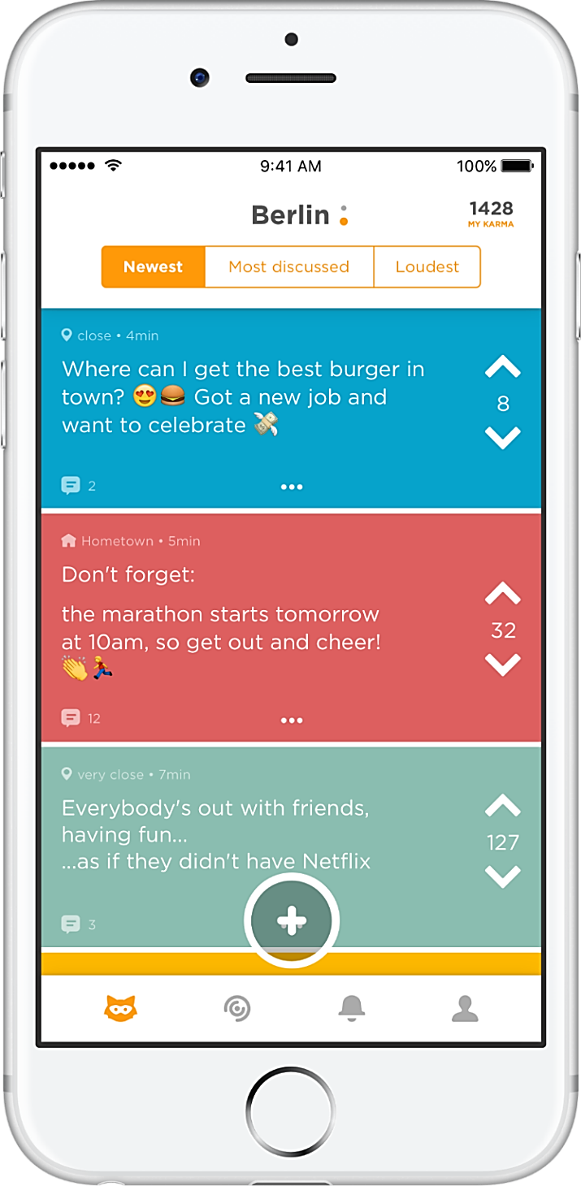



Motivation – Content in Social Media
Motivation – Content in Social Media
Community
Feed
24/7 everyday communication
Lots of platforms
  RW focuses single (US/EU) markets
We focus on Jodel in SA
Unique design features
  Anonymity
  Hyperlocality
Given these very same features
  What do Users talk about?
  What is the intent for posting?
But WHY
SA?
a “Jodel”
(thread)
Distinct Communities
(by design)
Communciation
Intents & Topics
Up-/Downvote
& ‘Karma’
Notes:
Thanks to internet
Short Messaging & Social Media
dominates our everyday comunication.
(#) lots of RW;
However MOST focusses
on single community (US/EU market)
--- or they do not have distinct communities.
What we find & the main message is:
--- small world networks if applicable
--- the rich get richter, Power-Law
(#) In this work, we focus on Jodel.
Which combines 2 key design features
Anonymous
Hyperlocal
--- content is only displayed in the proximity of a user – ~20km
→ forming independet communities
(#) This made us wonder:
--- given the same ingredients,
what do users talk about within the app?
what is the intent on communication?
(#) So, some words about the app first
(#) Most important things are
Community
Different Content Feeds
We have actual contnt - Jodel Threads + replies underneath
We can vote Up- or Down – resulting in a cumulative Karma Score
(#) WHY?
1. Dataset: SA - second largest user base
& a very interesting – no RW for cultural background
& Moreover Jodel usage has suddenly kickstarted (more on that later)
(#) Jodel is perfect:
- Hyperlocality forms Hundreds of independent communities
(#) Our Goal: Systematic Qualitative Analysis of Content
But let‘s talk about some more RW first
(#)

Slide 3
Related Work
Focus
US/EU markets
Hyperlocality <> Location Based SN
Surveys
  Information & entertainment [1,2]
  social, local, and anonymous identity [3]
(Self) Supervised Learning
  ephemeral in an impersonal [4]
  no personal information [4]
  Spatial topic distances [5]
  Personal Admission, General Entertainment & Info [3]
Anonymity
  Toxicy yes/no [1,6]
  Broader Topics/More personal [7]
Topics [8]
  Dating & Sex, Local Life & Weather, Education & Work, Health & Drugs, Politics & Religion
Intents [3,9]
  Personal Admission, Observation, Information & Advice, Opinion, Venting/Complaining
Cultural Environment
  Internet provides open spaces to KSA women [10]
  Driving Ban Lift, Integration of Woman Labor
  Questionable freedom of speech within KSA [11]
Notes:
Hyperlocality refers top pointing posts to locations
vs. Location-Based Social Networks (LSBN) align content to location
(more on that on the next slide)
Most related are apps like
Whisper (images)
or YikYak (alike Jodel, but offline nowadays)
(#) There have been qualitative surveys
Information & Entertainment + community identities
(#) Empirical Measures & (Self) Supervised Learning
ephemeral,
Impersonal, BUT others find Personal Admissing/Confessions
Spatial distinct communities differ
(#) Anonymity impact
usually non-toxic
Downfall YikYak abusive content
Toxicity shown on 4chan
Wrt platform content
(#) Topics
Dating & Sex
Life & Weather, Local Information
Education & Work
Health, Fitness & Drugs, Alkohol
Politics Religion
(#) Intents
Personal Admissing / Confessions
Sharing Observations
Information & Advice
Opinions
Social Venting / Complaining about others
(#) However, all of these works focus on either US or EU markets
(#) A different cultural background may influence content
As has recently been shown empirically by us in a recent paper
Within qualitative Interviews, internet provides new opportunites for women
Driving Ban Lift
Integrating women to the labor market
Yet still, amnesty complains about questionable freedom of speech
We complementary qualitative study
WHY & WHAT
So, as we are on the LocWeb workshop,
we define Hyperlocality next (#)
1 Lee2017people
2 vatelausyikyak
3 heston2016invisiblecities
4 black2016anonymous
5 Mckenzie2015oxen
6 papasavva2020raiders
7 Correa2015many
8 Wu2017TPU
9 Strangers_on_your_phone
10 guta2015veiling
11 amnesty2020report

Slide 4






Hyperlocality (I)
Posts / Replies bound to location
N
Notes:
(#) we define Hyperlocality as binding all posts/replies to a location
(#) so lets assume we have a user anywhere on a 2d map
(#) and she leaves a new post on the platform
(#) now we show other users and their community radius (~10-15km)
(#) so now our first user has a permanent reference to this post and can interact with it

Slide 5
Hyperlocality (I)
Posts / Replies bound to location
N
Notes:
(#) The users can now interact within this thread
Replying
or Voting
Others outside of this particular location
By margin of the radius do not see this post.
I promised to come back to the kickstarted ussage,
Which we will do next briefly.
(#)

Slide 6

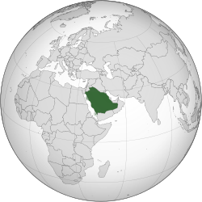
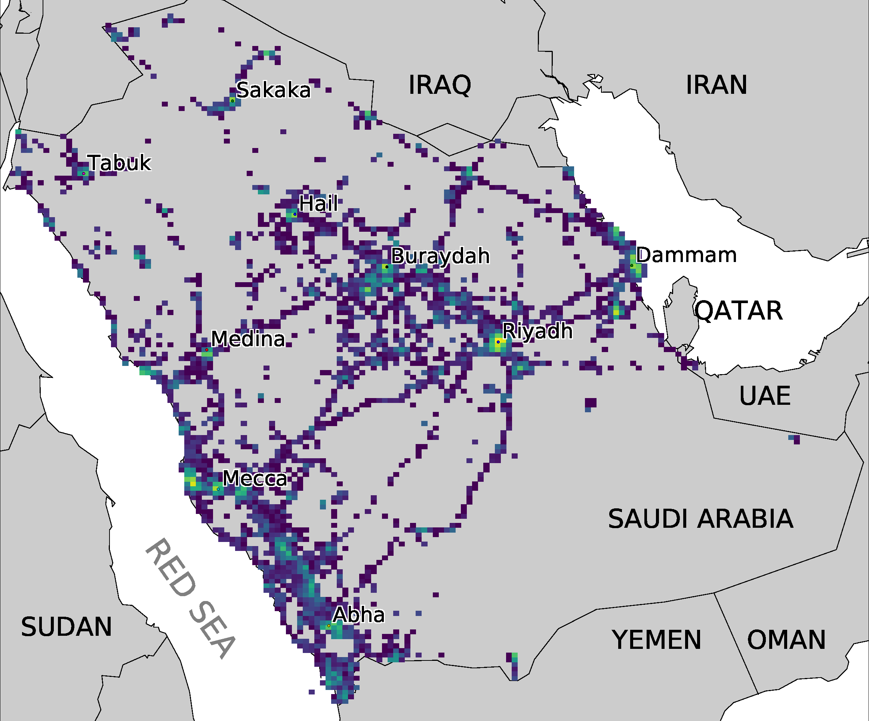
Used Dataset & Corpus
*https://en.wikipedia.org/wiki/Saudi_Arabia
Ground truth information from operator
Textual content - 15k random sample
Hashtag occurrences
Type | SA
Users | 1.2M
Content | 469M
Interactions | 961M
Notes:
First things first,
some words about the used dataset.
(#) We use ground truth information from the operator
As shown is this heatmap
where we can identify cities and roads
(#) a random sample of texts
and used hashtag counts
(#) and some metadata
Users
Conten
interactions
But lets get back to the sudden kickstart.
(#)

Slide 7
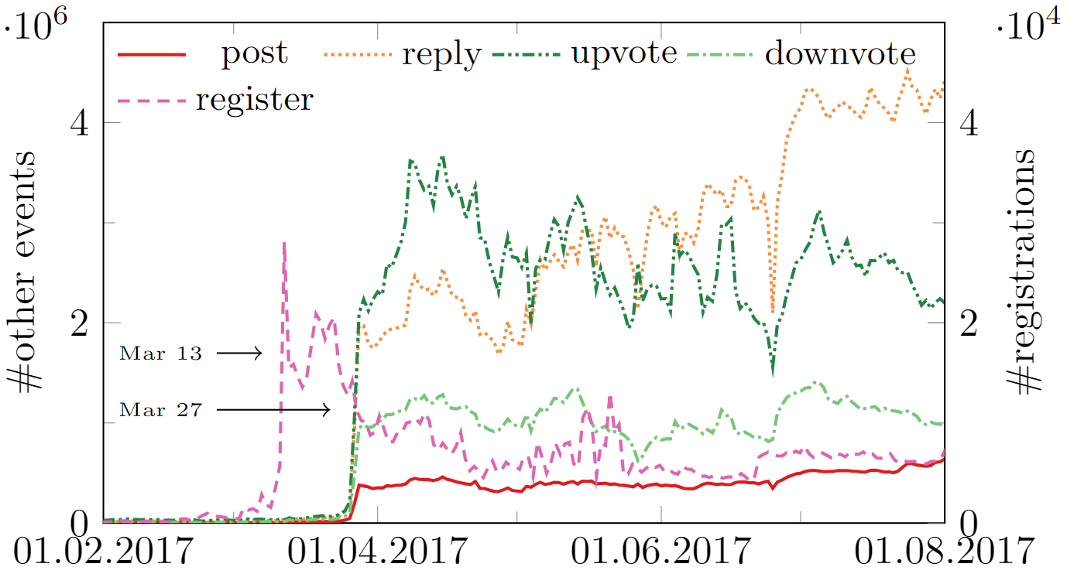
Interaction Volume
steep
Usage Increase
So, WHAT
happened here?
Time
Notes:
As promised, I also wanted to show another reason why
Jodel KSA is interesting.
Therefore, look into platform usage over time
(#) I sketched development in green
(#) as if Jodel was turned on / sigmoid with steep increase
(#) So what happened here?
Imagine you have a massive wall of Arabic text
find out
the WHY and
The WHAT
User talk about,
We next talk about
our Approach
(#)

Slide 8


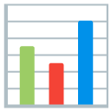
Approach to Intents & Topics
Classifcation
Schema
Evaluation
Crowdsourcing
Campagins
Notes:
-- Idea to split derived from related work
but foremost from experience
(#)
We set out creating a
generic content classification scheme
for Jodel KSA
We do crowdsourced campaings
and provide Evaluation
wrt Schema
wrt Jodel KSA
Next stop will be the schema & campaign setup
(#)

Slide 9
Classification Schema & Campagin Design
Schema
Goal
  Intents
  Topics
Trade-Off
  Coverage (few Other)
  Non-Overlap
  Minimal Set
Begin with prior work [5,10,16]
  Iterative refinement on random samples
Study Design
Focus on Thread start
2 Expert Annotators
  Learn Schema
  Discuss & Create Coherence
Multiple runs
Notes:
(#) First, our GOAL, as said is to fetch
Intents (WHY)
Topics (WHAT)
(#) Classifcation carries inherent trade-off
cover most content (few OTHER)
Non-overlapping classes
Minimal set, but still sufficiently informative
(#) We base upon experience and prior work
Then refine our schema
(#) We only focus on Thread start
otherwise, contents change over threads
We employ 2 annotators for main campagins
Need to learn schema
Discuss disagreements
Create coherence
Then do multiple runs
To show you how this looks like,
Here is our classification system
(#) <- here comes the classification system

Slide 10
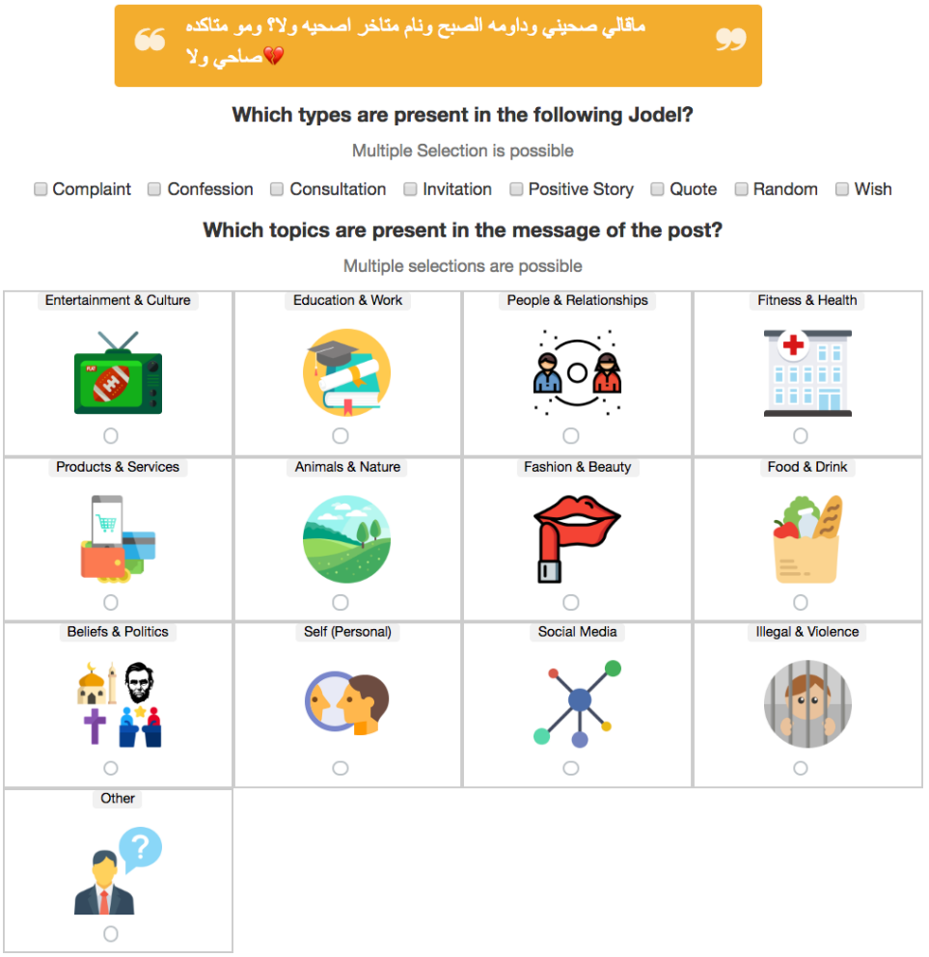
Classification Schema & Campagin Design
Schema
Goal
  Intents
  Topics
Trade-Off
  Coverage (few Other)
  Non-Overlap
  Minimal Set
Begin with prior work [5,10,16]
  Iterative refinement on random samples
Study Design
Focus on Thread start
2 Expert Annotators
  Learn Schema
  Discuss & Create Coherence
Multiple runs
Notes:
Here, a post is shown,
Then possibly multiple questions may be asked.
Quite simple.
But enough, I am sure you want to see RESULTS
(#)

Slide 11

Results
In line with
Related Work
Coverage
could be better
especially includes localation-related content
Notes:
(#) First, focus on Intents
Note that this includes lots of local references
(events, cafes, university, shops,. ..)
Seeking Interaction / Info ++ Self Expression very popular.
(#) As for Topics
A lot about People & Relationships + about oneself
And others...
(#) Top items are in line with RW
(#) Unfortunately, Coverage could be better
Sticking to this topic: how good is the schema overall?
(#)

Slide 12
Campagign & Schema Quality (I)
Agreement (Krippendorf Alpha + weighting)
  Mostly substantial
  Only moderate on Topics at times
Qualitative Annotator Feedback
  Non-Toxic
  Young People / Teenagers
  Seeking interaction (games, other sex)
Notes:
(#) We measure annotator Agreement with Krippendorf Alpha
Is substantial for Intents
Moderate to substantial for Topics
(#) We have lots of qualitative feedback from refinement & discussion rounds
Largely Non-Toxic
Probably most Young people / Teens (no demographics available)
Many seeking for any interaction – games & from the other sex
Ok, but how is this reflected in the data?
Therefore, we take a look at the confusion.
(#)

Slide 13
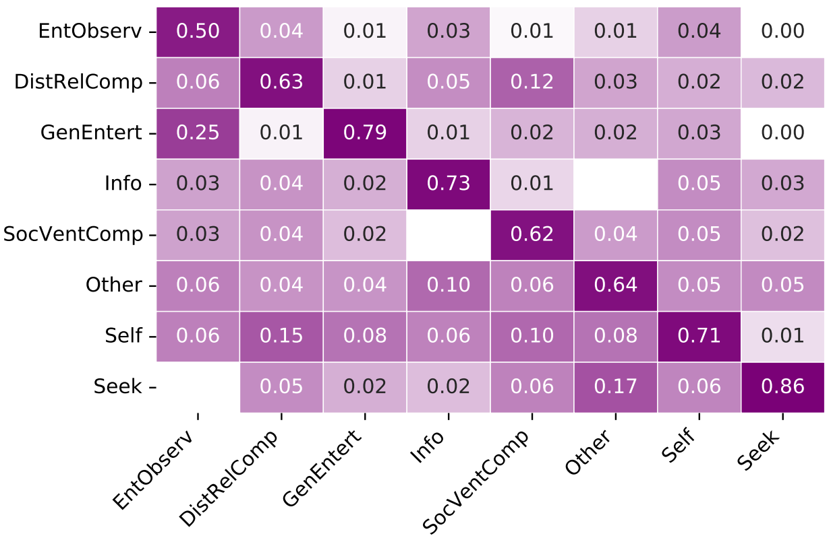
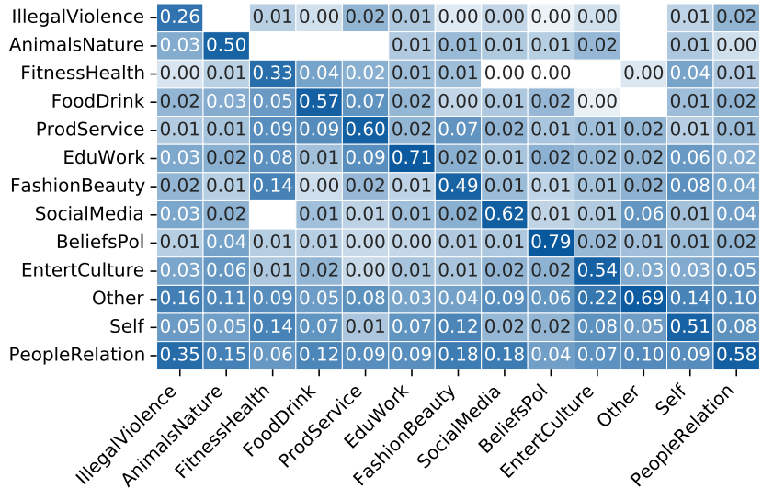

Campagign & Schema Quality (II)
Multi-Annotator Confusion
Intent
Confusion relatively low
Topic
Confusion
higher
Precision
could be better
No Model
is perfect.
Notes:
We now inspect the confusion between annotators
(#) Intents
(#) Topics
(#) First, we observe a strong diagonal, good
(#) the confusion values for topics are higher
(#) Some may be explained – like Class Similarities in Entertainment
(#) Others may not necessarily.
(#) So the precision could be better (that the trade-off in the schema)
(#) No model is perfect. Schema Creation is HARD.
So let us next look into our results from a city perspective.
(#)

Slide 14
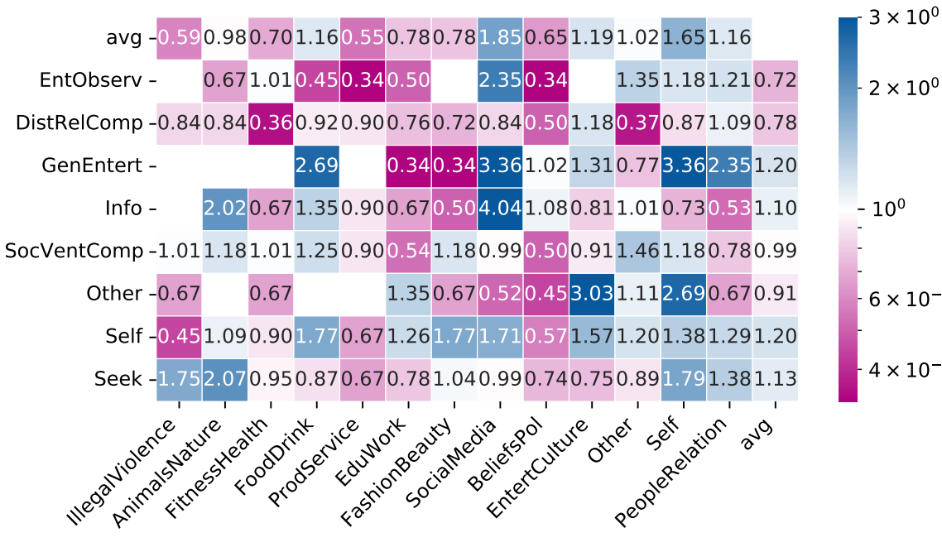
Inhomogeneity: Jeddah vs. Riyadh
broader spectrum
In Riyadh
more content
Jeddah
more content
Riyadh
Focus on Entertainment
In Jeddah
Notes:
That is, we show differences for Jeddah to Riyadh
Both are the biggest cities:
Riyadh – bigger
Jeddah – smaller, believed to be more liberal & open
(#) We plot our Intents & Topics as a heatmap
(#) where the z-axis denotes the relative pdf difference
Blue = more in Riyah
Pink = more in Jeddah
(#) So the result looks like a wild scatter,
(#) However, average aggregations show
that there is a broader topical spectrum in Riyadh
(#) whereas the Jeddah communty focuses more on
Entertainment
So we find differences in spatially distinct communities
That is nice, but we felt that our schema is missing a qualitative aspect.
-- as seen in the keynote: more everyday life
Thus, we finally look into the top-used hashtags.
Skip time over Hashtags?
(#)

Slide 15
Qualitative Insights:
Top Hashtags
Hashtag | Hashtag
#ميولك_الجنسي #your_sexual_orientation | اسم_بنت_نفسك_تشبكها# #name_of_a_girl_you_wish_to_date
تشبيك_صريح# #Honest_matchmaking | اسمك_و_نخمن_مز_و_لا_شاكوش# #say_your_name_and_we_guess_if_you_are_hot_or_not
عدد_الكارما_ونعطيك_فوت_اب# #Share_karma_count_and_get_upvotes | حركة_تخرفنك# #a_move_that_turns_you_on
اسألة_انحرافية# #wild_questions | عمرك_وتتضبط# #your_age_and_get_hooked_up
رغبة_محرمة# #forbidden_desire | حملة_رفع_الكارما# #raise_the_karma_campaign
شبكو_بعض# #matchmake_each_other | كرسي_الاعتراف# #confession_chair
اعترافات# #confessions | قول_احبك_لاسم_عشوائي# #say_i_love_you_to_a_random_name
شي_يخرفنك_بالبنت# #things_which_turn_you_on_in_women | حملة_للصداقة_عمرك_جنسك# #a_campaign_for_friendship_your_name_your_gender
ليش_سنقل# #why_single | خطابة_يودل# #jodel_speech
رسائل_لن_تصل# #messages_which_will_never_arrive | لعبة_اول_واحد_يعلق_يطلب_طلب# #the_first_person_to_comment_can_ask_a_favor
The Story of Happy Marriages
  Kissing
  Things that turn you on
  Marriages Hopes & Fears
  Why Single?
  Matchmaking
  Marriage Conditions
  First Night in Marriage
  Behavior During Sexual Intercourse
Notes:
We had access to all used hashtags & counted occurrences.
(#) This is the result.
(#) Some are about Self-Admission/Confessions
(#) Others about expoiting the platform to gather Karma (in app gamification)
(#) Yet, remaining are about matchmaking, seeking interaction, and the other sex
Skip time?
(#) Which brings us to the story of happy marriages.
(#) We find lots of hashtags around finding a partner,
Being single, or the first night of a marriage
(#)

Slide 16
Summary
Created Annotation Schema
  Intents
  Topics
Crowdsourced Annotation Campaigns
  Agreement moderate/substantial
  Schema has weaknesses (trade-off)
Findings in line with RW
  No toxicity
  Predominant: Entertainment, Seeking Interaction, Social Venting, Self Expression
  Inhomogeneous Spatial Communities
Classifcation
Schema
Evaluation
Crowdsourcing
Campagins
Notes:
So to summarize briefly:
(#) we created an annonation schema for
Intents & Topics.
(#) We crowdsourced annotations
And show that results may have been better
But we argue that this is fine for qualitative insights
(#) Our findings are mostly in line with RW
No toxicity
Probably rather ephemeral
Entertainment, Social Venting, Self Expression
(possibly due to anonymity)
(#) We identify inhomegenity between
spatially distinct communities

Slide 17


Check out the paper for more!
... now it is time for discussions.
https://h.reelfs.de
Notes:
I hope you enjoyed this talk
And I know that it sort of opens more questions than it answers.
Lastly, if I did this study again – I would do it differently.
I would also like to put emphas on the time necessary to develop our schema
Crowdsourcing is hard – and it begins with the questions we ask.
Check Out the Paper for more
if interested in this topic, checkout my website as well
Thanks.
Now it is time for your questions!

Slide 18
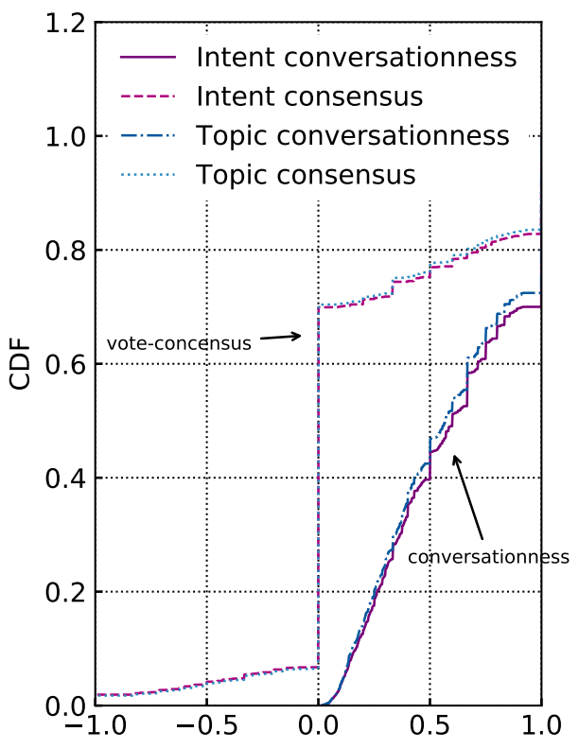
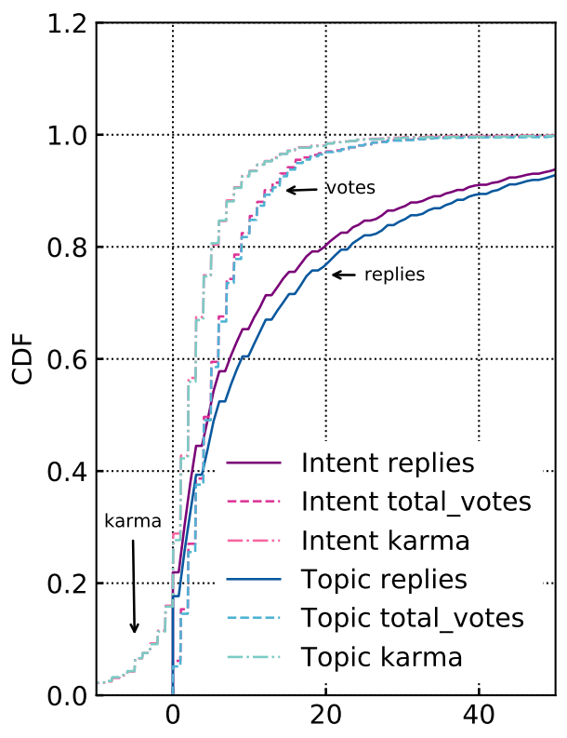
Empirical Measures

