Slide 1

Understanding & Predicting User Lifetime
... with Machine Learning
Jens Helge Reelfs†, Max Bergmann†, Oliver Hohlfeld†, Niklas Henckell‡
†Brandenburg University of Technology
‡The Jodel Venture GmbH
The 11th International Workshop on Location and the Web @TWC’21
April 12, 2021
Notes:
Hello & Welcome
I am Helge, 5th year PhD Student at BTU
FIRST Thanks:
organizing committee of the LocWeb Workshop rich in tradition
Reviewers for valuable feedback
Today, we talk about OSN User Lifetime & BEYOND
Joint Work with
My Student Max just having received his Bachelor‘s degree,
Oliver
and Niklas
I have lots of results I want to share with you, we will see how time fits.
SO.
Lets directly go ahead and start with a short MOTIVATION

Slide 2
Motivation - User Lifetime Prediction
User Lifetime / Churn / Retention; Customer Lifetime Value (CLV)
Does user x quit business soon?
How long will user x stay with us?
Within timespan t? With what probability?
How much revenue does user x generate in timespan t?
Why is it important? – Increase Retention
Focus on new customers likely to churn
Focus on A-customers
Has been studied extensively…
Notes:
User Lifetime prediction
Also known as
Churn
Retention
From a marketing perspective: Customer Lifetime Value – CLV
No matter how the question – ULTIMATELY THE SAME
There has been loads of work over the last 2 decades

Slide 3


(Lots of) Related Work
Plethora of Tools for predictions
Classical Machine Learning – Boosting, SVM, DT, RF, …
Association Rule Mining
(Deep-)NNs
…
Plethora of application fields
Telco
Gaming
OSN, Q&A
Shopping, …
Mostly focus on single gobal platforms/communities
… even after decades
Still lots of really cool stuff going on!
But wait,
what is NEW here then?
Why LocWeb?
Notes:
Without going into any detail each of them actually deserve, There is…

Slide 4
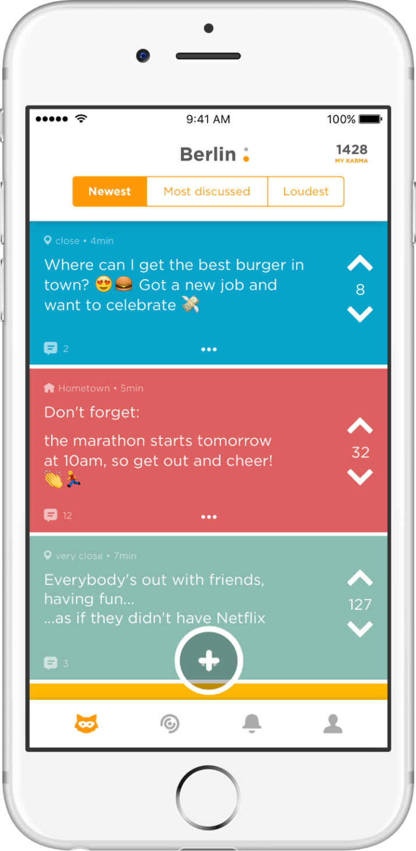

Jodel App
Community
Feed
Distinct Communities
(by design)
Unique properties
Location-based
Anonymous
Microblogging/Chatting App
Text
Images
(Short videos)
Set out in Germany late 2014
Popular across Europe & Gulf states
Mostly Students & Pupils
a “Jodel”
(thread)
Up-/Downvote
& ‘Karma’

Slide 5
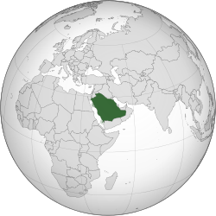

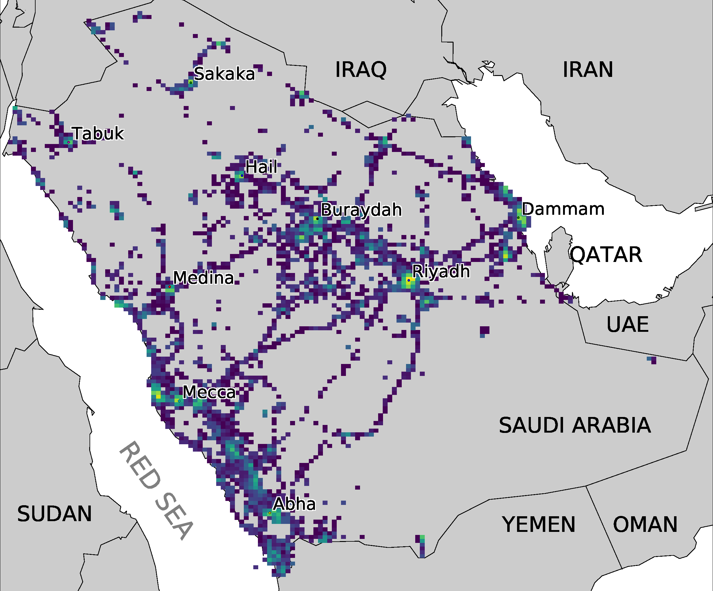
Used Dataset
* https://en.wikipedia.org/wiki/Saudi_Arabia
Ground truth information from operator
Kingdom of Saudi Arabia
10/2014 until 08/2017
Factsheet
No lurking information
Metric | #
Users | ~1.215 k
Posts/Replies | ~59 M / ~411M
Casted Votes (Up / Down) | ~350 M / ~143 M
Discretized Communities | 95
~1:1 for
Content Creation
vs Content Appreciation
(1:4-9 across EU/US)
Distinct Communities
(by design)
Notes:
1:1 is a cultural finding within the Gulf states & presumably in the rather arabic-spaking MENA countries.
They show more focus on content creation in contrast to western countries that prefer voting.
(super interesting topic – at least there are few articles/papers already on this topic)

Slide 6

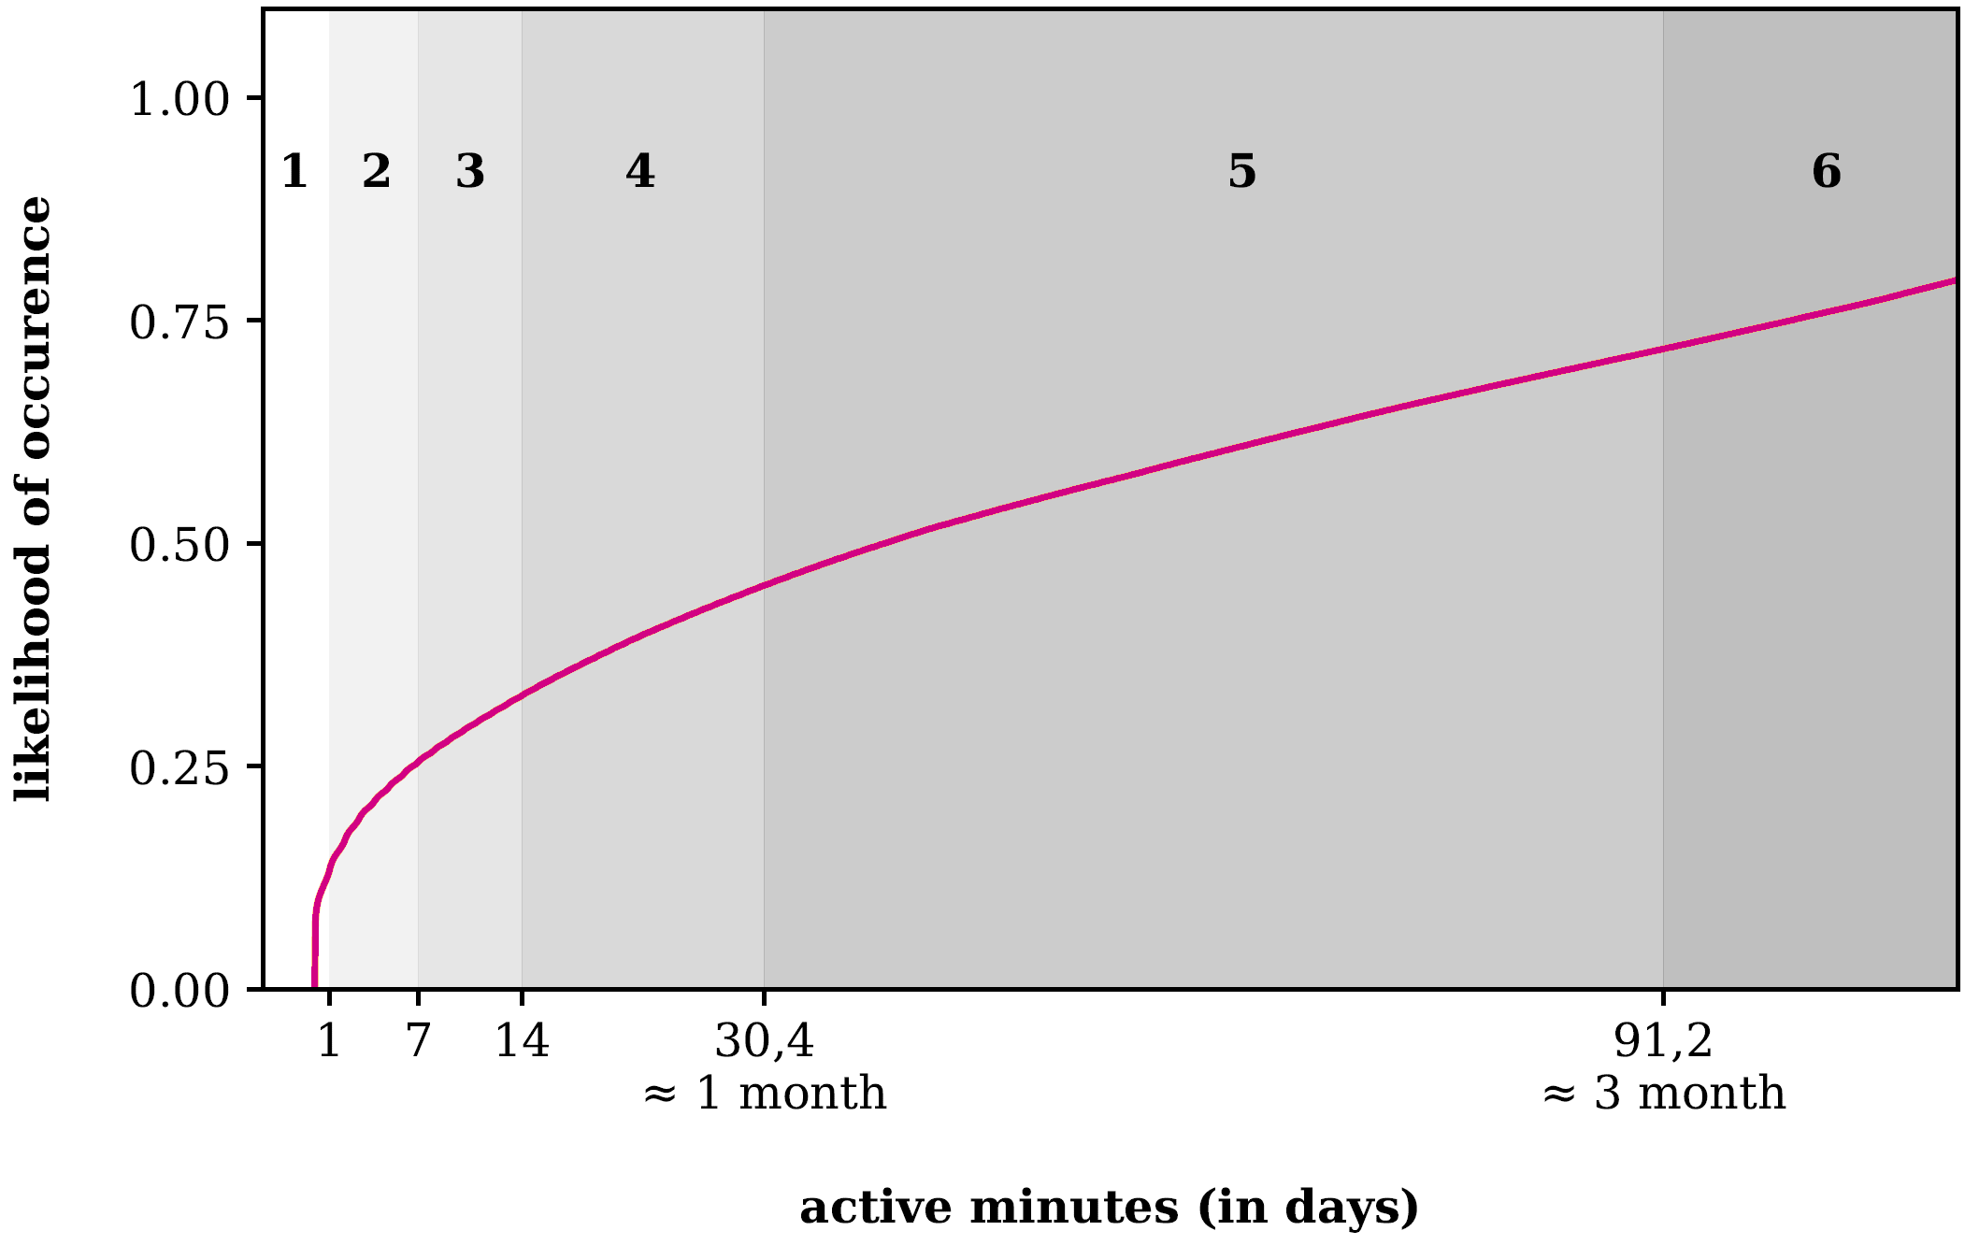





Optimization Target: User Lifetime – Population & Discretization
Focus on
Early-dropouts
Class | Lifetime | #class / #total
1 | 0 ... 1 days | 13.3 %
2 | 1 ... 7 days | 12.1 %
3 | 7 ... 14 days | 7.4 %
4 | 14 ... 30 days | 12.3 %
5 | 1 ... 3 months | 26.4 %
6 | > 3 months | 28.4 %
Hey Jodeler!
We noticed that you have not yet checked out the latest pics from our lovely @Jodelzoo channel!
Take a look here for your monthly top 20.
Best wishes from the JodelHQ,
Niklas.
cdf
Notes:
OPTIMIZATION TARGET user lifetime CDF
We derive classes
Focus on smaller ones – more likely to churn, most users
Example subtle notification to increase retention – CAT PICS always work.

Slide 7
Research Questions
Can we create good predictive models
for User Lifetime?
Do community-tailored models
generalize?
What do we learn
from built models & their application?
Notes:
That said, what are we answering?

Slide 8
This Talk’s Structure & Pipeline
Database
Metadata
(community, posts, votes)
Data Preparation
Scaling
Imputing
ML
Classification
Regression
Balancing
Evaluation
Community Models
Cross-Application
Country Model
Feature Importance
Empirical Feedback
Temporal Feature Analysis
Feature Engineering
User
Community
Temporal
Tools
Notes:
TEXTBOOK ML pipeline

Slide 9







Domain specific Feature Engineering
User features
Posts created, answers received
Votes casted, votes received
Community features
Post-/Vote activity
Happyratio (up vs. downvotes)
Temporal expansion (aggregates over time)
according to class time periods
better time-invariance
#features | User | Community
Time-dependent | 50 | 16
Time-independent | 28 | 1
Notes:
2 different TYPES / sources
SUM 95

Slide 10
Machine Learning - Details
Regression
R² (area under curve)
Classification
macro F1 (harmonic mean precision/recall)
Off the shelf python sikit-learn, imbalanced-lean
5-fold Crossvalidation
Mean Imputing → best overall results
Scaling, Balancing → no significant improvements

Slide 11
Tool Grid-Search
Regression: How long will user x stay? [minutes]
Classification: How long will user x stay in discrete measures?
All data (Country)
Various algorithms
Various hyperpparameters
Algorithm | Regression R2 ± stddev | Classification F1 ± stddev
Baseline | 0.0000 ± 0.0000 | 0.1672 ± 0.0007
RF | 0.9822 ± 0.0004 | 0.9668 ± 0.0005
DT | 0.9580 ± 0.0009 | 0.8049 ± 0.0095
MLP | 0.9668 ± 0.0036 | 0.6768 ± 0.0304
AdaBoost | 0.7654 ± 0.0012 | 0.6720 ± 0.0093
KNN | 0.6764 ± 0.0013 | 0.5077 ± 0.0006
SGD | 0.3422 ± 0.0551 | 0.1686 ± 0.0191
better
Random Forest
performs best

Slide 12

Invidual Community Models
Regression: How long will user x stay? [minutes]
Classification: How long will user x stay in discrete measures?
Community | Regression R2 ± stddev | Classification F1 ± stddev | #Users
Country | 0.9822 ± 0.0004 | 0.9668 ± 0.0005 | 1,012k
Riyadh | 0.9828 ± 0.0013 | 0.9531 ± 0.0006 | 284k
Jeddah | 0.9667 ± 0.0016 | 0.9372 ± 0.0008 | 101k
Mecca | 0.9551 ± 0.0035 | 0.9185 ± 0.0039 | 45k
Al Bahah | 0.9457 ± 0.0032 | 0.8752 ± 0.0093 | 11k
Al Jafr | 0.8219 ± 0.1115 | 0.5807 ± 0.0594 | 174
Overall very good performance
Moderate complexity sufficient
Depth >32
Estimators >32
diminishing returns
Downsampled Country Input
→ Similar to individual models
better
Distinct Communities
(by design)
User behavior similar
wrt Lifetime
Spoiler:
The same in DE
… working on it!
Notes:
So, we have seen the Country model before here.
Now here we go with the community-tailored models

Slide 13
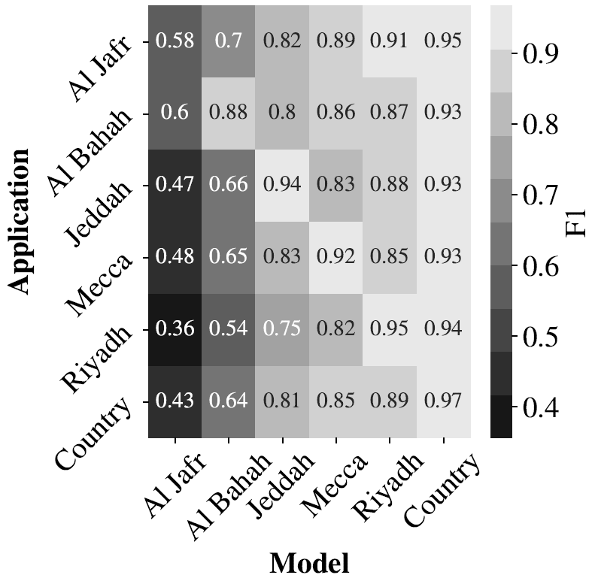
Generalization
Model cross-Community Application
Bigger cities
similar
Country Model
generalizes best
Country Model
performs best

Slide 14
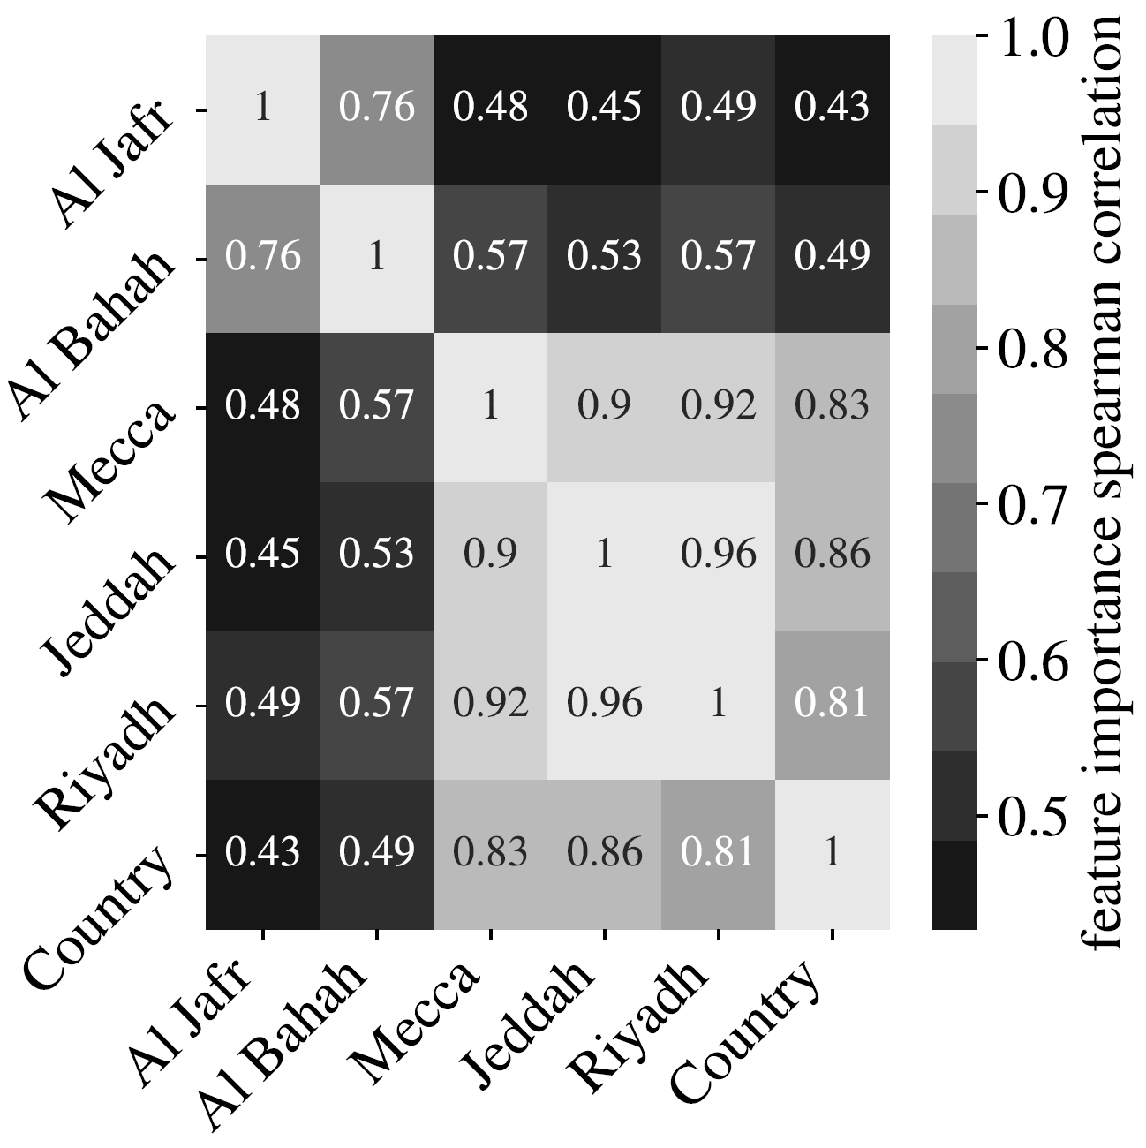
Feature Importances
We tested lots of estimates
Random Forest FI here
Gini-Coefficient
~ #decisions involved %
Spearman - Ranked Correlation
Smaller <> Bigger
Cities similar
Country Model
slightly different
Notes:
So, we can check all promised todos within the pipline now.
But (if time) there is another PRACTICAL FINDING

Slide 15
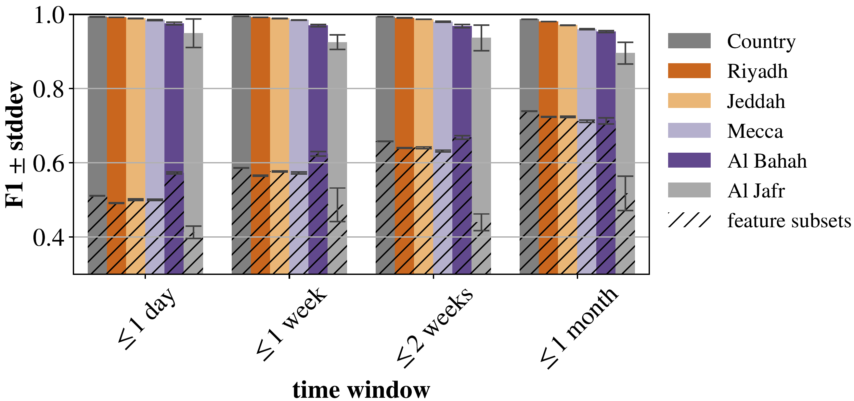
Binary Classification
Does user x quit within the next timespan t?
In practice Focus on smaller Lifetimes
Ease up the problem
Baseline feature subset classification
Deal with limited information
Limit amount of data
very promising
Classification results

Slide 16
Future Work
Feed Feature Importances back into Empirical Analysis
→ Derive behavioral differences between classification partitions
Expand evaluation to DE (ongoing)
Improve prediction leveraging deep-NNs
Create other ML-projections with different optimization targets
→ Landscape of implicit community-deltas wrt various features

Slide 17
Conclusion
Off the shelf ML methods work well
Scaling/Balancing does not improve
RF/DT perform best
Tailored community models do not perform better than (sampled) country
They generalize quite ok-ish
Despite distinct communities
There is similarity wrt Lifetime
Models‘ internals also work similarly
Can we create good predictive models for User Lifetime?
Do community-tailored models generalize?
What do we learn from built models & their application?

Slide 18

Thanks!
... now it is time for discussions.

Slide 19
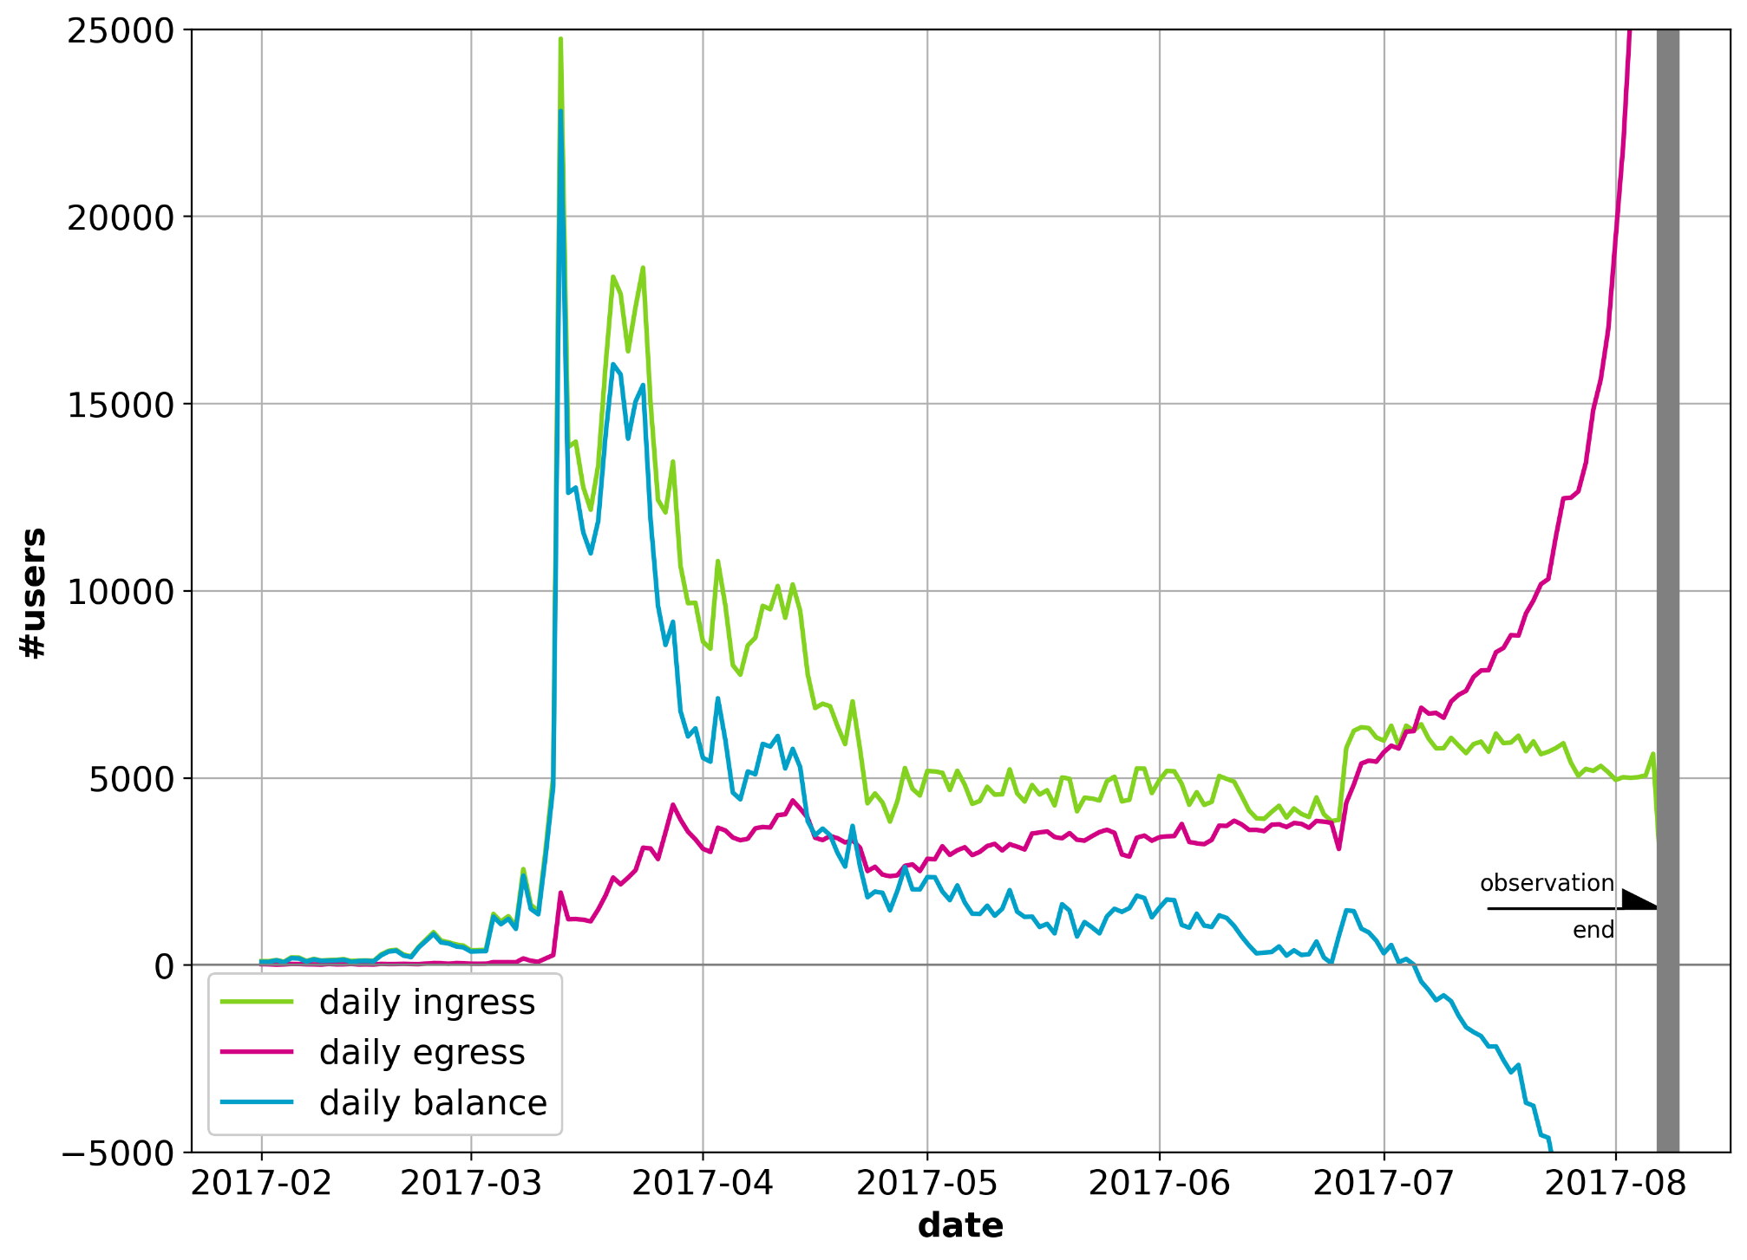
User Ingress vs. Egress
Overall:
Short timeframes

Slide 20
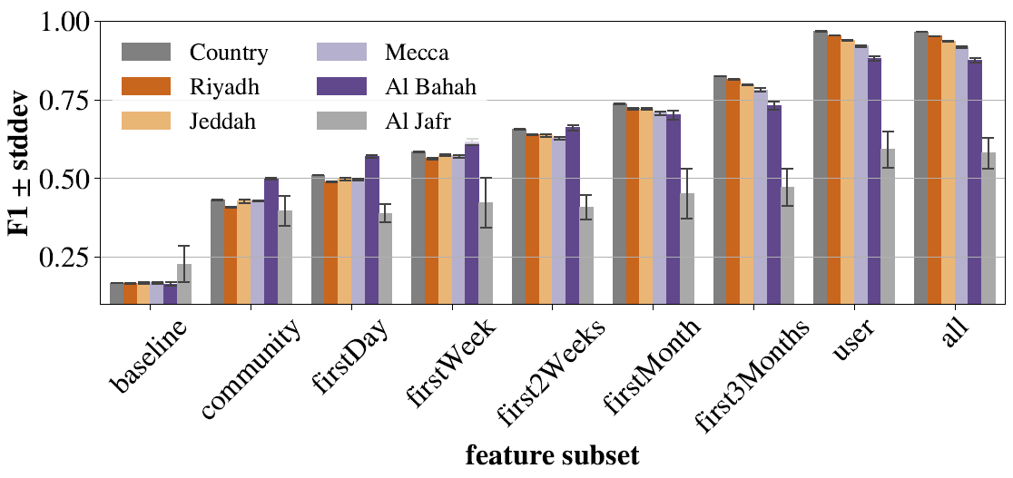
Random Forest – Feature Subset Analysis

Slide 21
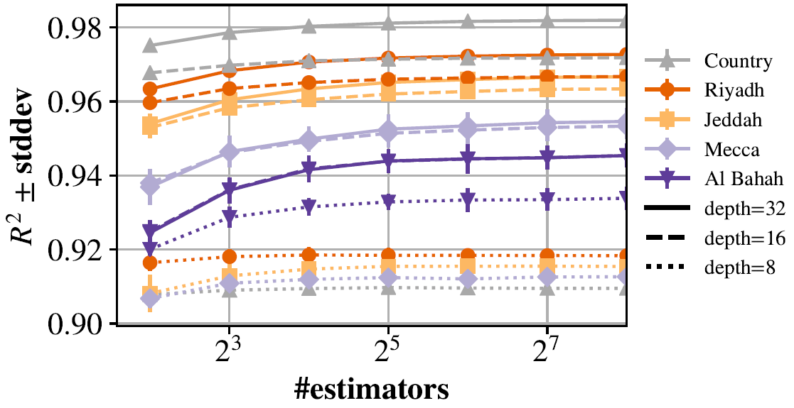
Random Forest - Complexity

Slide 22
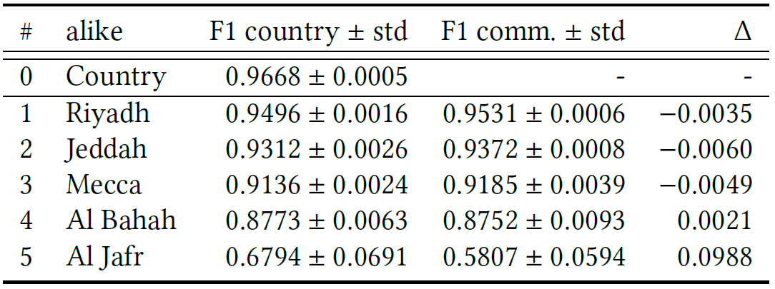
Random Forest – (Sampled) Country Model

Slide 23
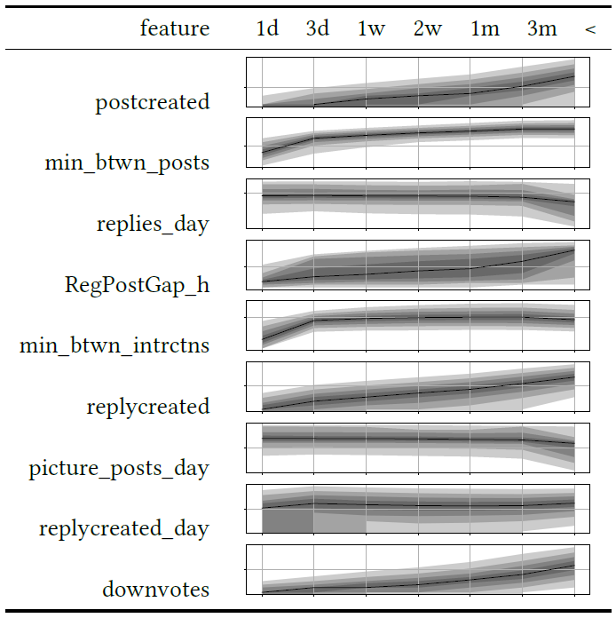
Empirical Feedback
most important

Slide 24
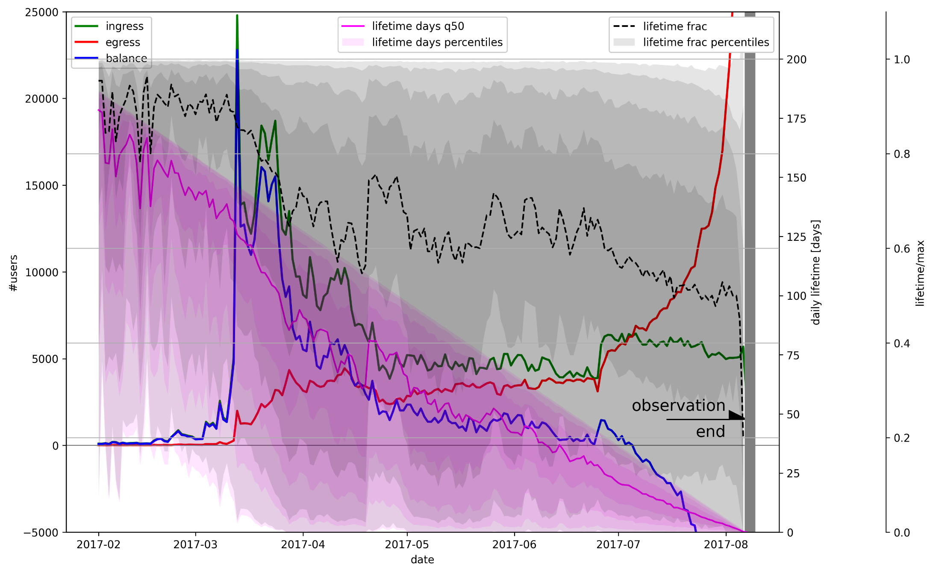
User Ingress / Egress & Lifetime

Slide 25
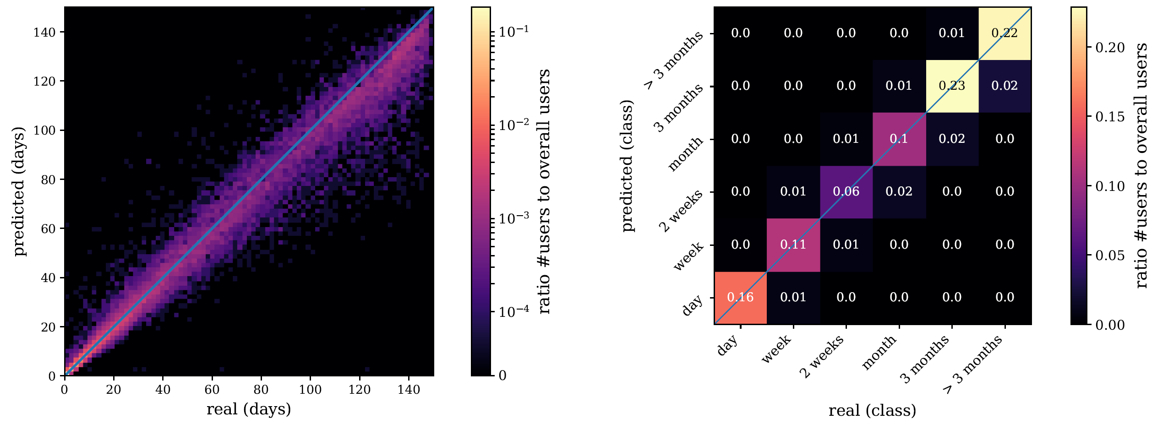
Example ML Results - Jeddah

Slide 26
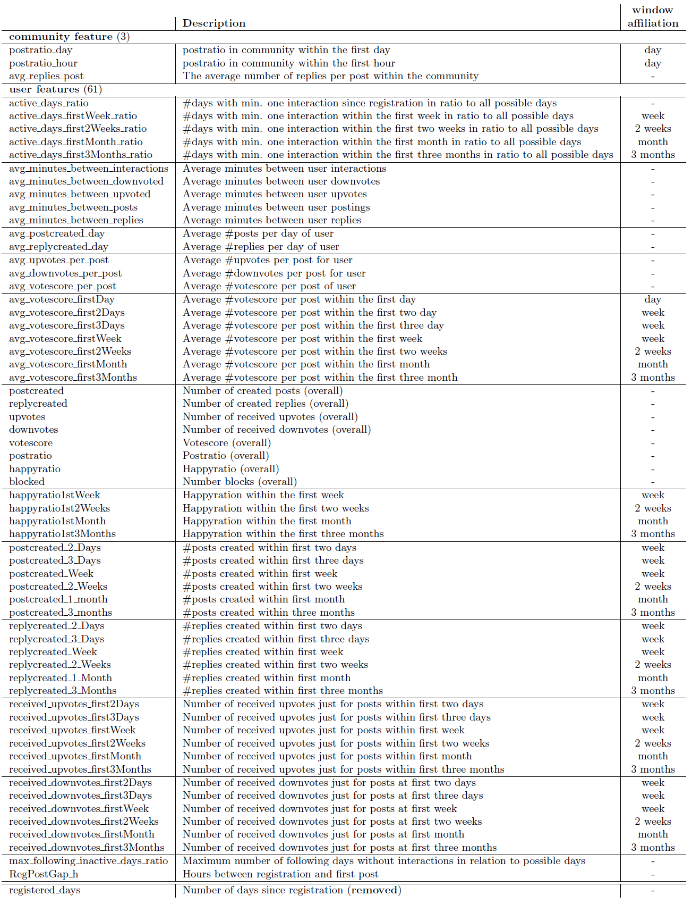
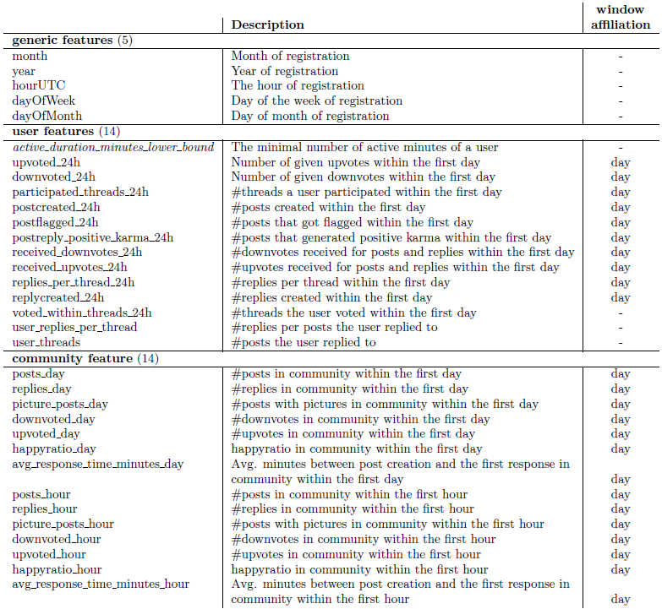
Features

