Slide 1
Application Agnostic Offloading of Datagram Processing
Helge Reelfs
ITC 2018, Vienna, AT, September 2018

Slide 2
Shift towards programmability
Current example: SDN & NFV
Programmability has advantages
Hope for realizing faster & more flexible networks
Simpler implementations by modularization
Separated control
Flexibility has a price - How to make this fast?
Goal: Accelerate NF processing by task offloading
NFV = run in VM
Network function
frequent
subtask
offload for acceleration
Rule Processor
Notes:
ITC concerned performance modelling/aspects – we will set the focus on programmability leads to better packet processing

Slide 3
Networking Stacks – Where are we?
Increasing line rates challenge packet processing
CPU speeds do not scale with increasing line rates
Performance problems at high line rates (e.g. >>10Gbps)
Main overhead factors
Memory allocations and copy operations
System calls and context switches
Does it matter after all?
Source: Larsen et al., “Architectural Breakdown of End-to-End Latency in a TCP/IP network, J Parallel Prog, 37:6, (2009)
Notes:
High line rates vs. small packets
Copy Operations!
Does it matter in comparison to application overhead?

Slide 4
Current Network Stack & Current Answers (simplified)
Kernel-
Software
Classical
Network Stack
Bypassing
Kernel
Other HW
Offload
(not shown)
APP
APP
µSTACK
user
APP
kernel
Netmap/DPDK
TRANS
TRANS
TRANS
NET
NET
NET
kernel
HW
MAC
MAC
MAC

Slide 5
But where is the problem?
Stock Kernel
Too generic (on purpose) → slow
Other new APIs → limited success, very specific
Kernel-Applications
Possible security threat, updatability
Kernel Bypass
Enslaving NIC to single applications, tailored stack implementations
Other Offloading
Highly tailored to application and hardware
Isn’t there anything
in between?

Slide 6
Classical Network Stack (simplified)
132.187.12.42
Result
DNS-server
user
remove it!
CTX SW
Copy
kernel
TRANS
NET
kernel
CTX SW
Copy
hardware
MAC
Request
A record for
itc30.org?

Slide 7
Application Agnostic Packet Processor
Z
Z
Z
DNS-Server
control plane
user
kernel
132.187.12.42
Result
TRANS
AAPP
NET
kernel
CTX SW
Copy
hardware
MAC
Request
A record for
Itc30.org?

Slide 8
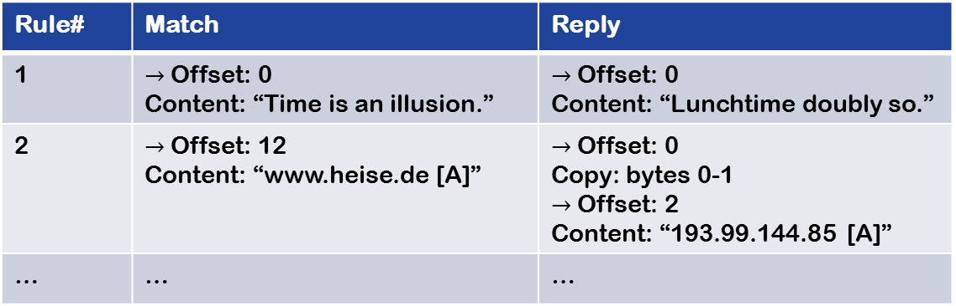
What is Application-Agnostic?
Efficient byte wise matching
Offset + Length
Simple construction of responses
Copy data from incoming packet
Copy data from template
Chaining of matching & construction rules
Rule# | Match | Reply
1 | $→$ Offset: 0 Content: “Time is an illusion.” | $→$ Offset: 0 Content: “Lunchtime doubly so.”
2 | $→$ Offset: 12 Content: “www.heise.de [A]” | $→$ Offset: 0 Copy: bytes 0-1 $→$ Offset: 2 Content: “193.99.144.85 [A]”
… | … | …

Slide 9



Evaluation: Testbed Setup
4 clients (dnsperf)
Uniform shuffled
workload
across clients
Server with AAPP Kernel
10 Gbps links
Modified Bind DNS server
Notes:
Each i7 4th gen 3,6GHz 8GB RAM
Intel x540 10GbE
Netgear Prosafe 10GbE Switch (copper)

Slide 10
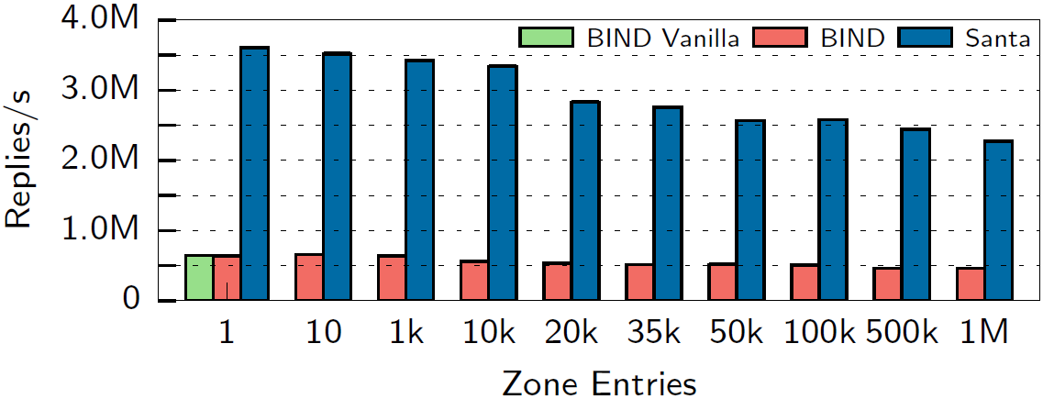
Evaluation: DNS Server – UDP Transport
Synthetic round robin workload
Speedup of factor 4.9 to 5.5
Speedup

Slide 11
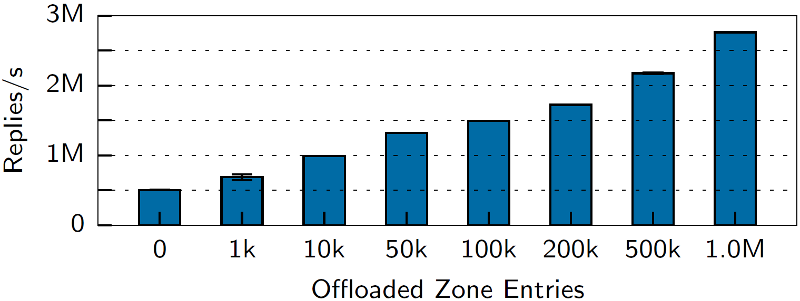
Evaluation: DNS Server – UDP Transport
Real World Power-Law Workload (~ ISP trace)
Offload top-N zones entries

Slide 12
Beyond the paper

Slide 13
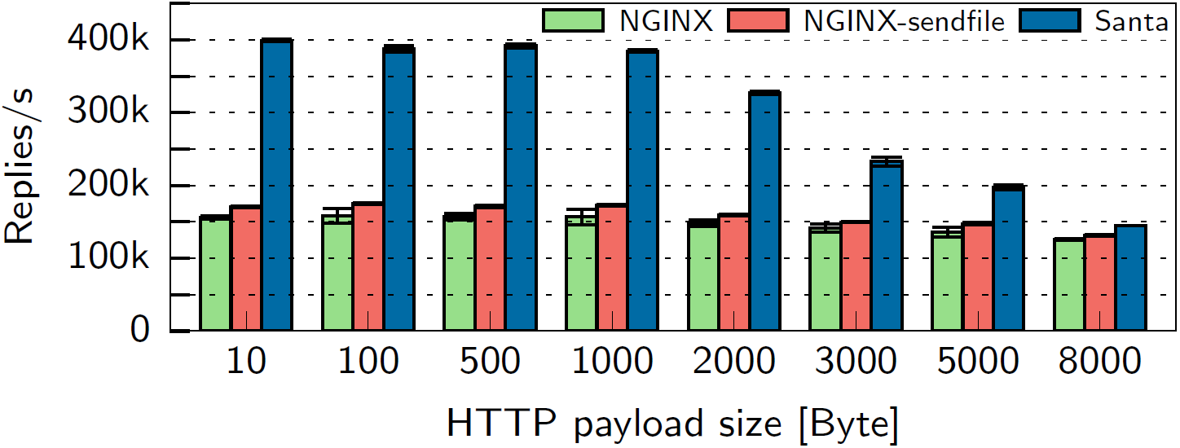
Evaluation: static HTTP Server – TCP Transport
Full throttle “GET /” from all clients
Speedup of factor up to 2.6
Speedup

Slide 14
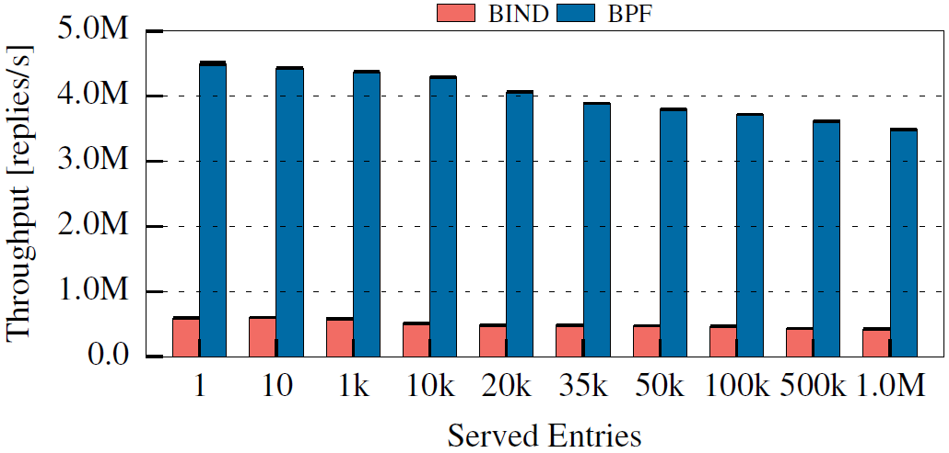
Going deeper! – eBPF to the rescue
APP
User
Successor of classical Berkeley Packet Filter
eBPF = „in-Kernel sandboxed virtual machine“
Running @ Linux TC subsystem
TRANS
IP
TC
Kernel
Driver/XDP
(Smart)NIC
HW
Speedup

Slide 15
Conclusions
Offloading processing has advantages
faster
This comes at a cost
Matching & Response language is restricted
TCP support is limited
Encryption not supported
May work with in-Kernel TLS
No user space encryption (e.g., QUIC)
Shift to eBPF enables safe arbitrary offloading
Lower layers lack functionality → only UDP
eBPF as a handy tool to network offloading!!?

Slide 16
Thanks.
Helge Reelfs
ITC 2018, Vienna, AT, September 2018

Slide 17
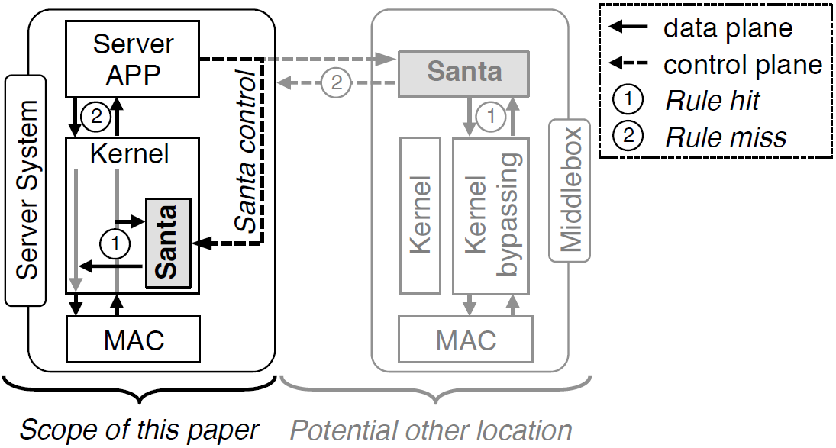
Offloading to other Host

Slide 18
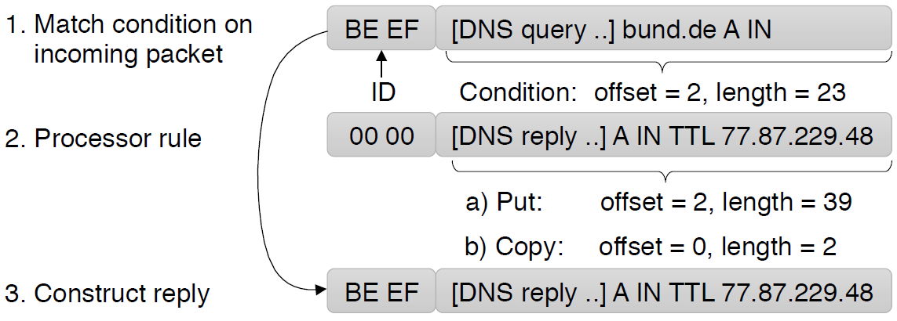
DNS Example

Slide 19
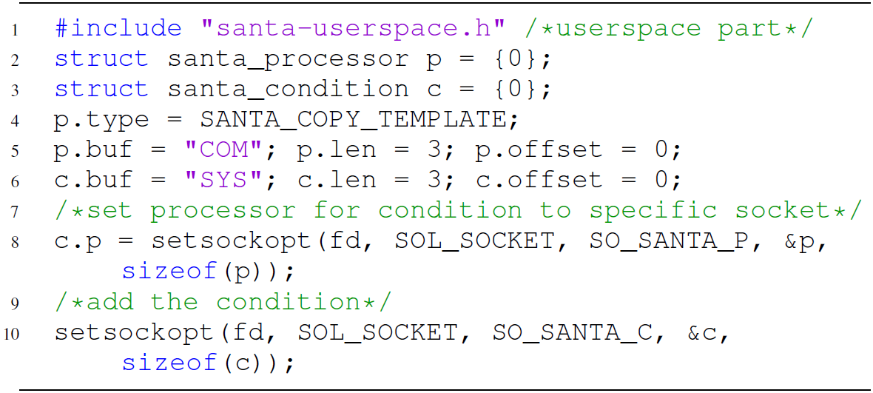
AAPP API

Slide 20
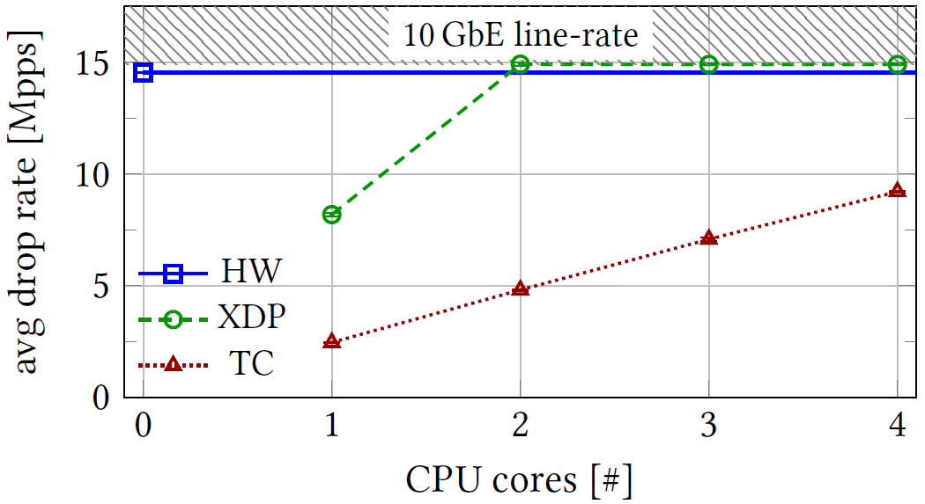
SmartNIC Offloading (Droptest)

Slide 21
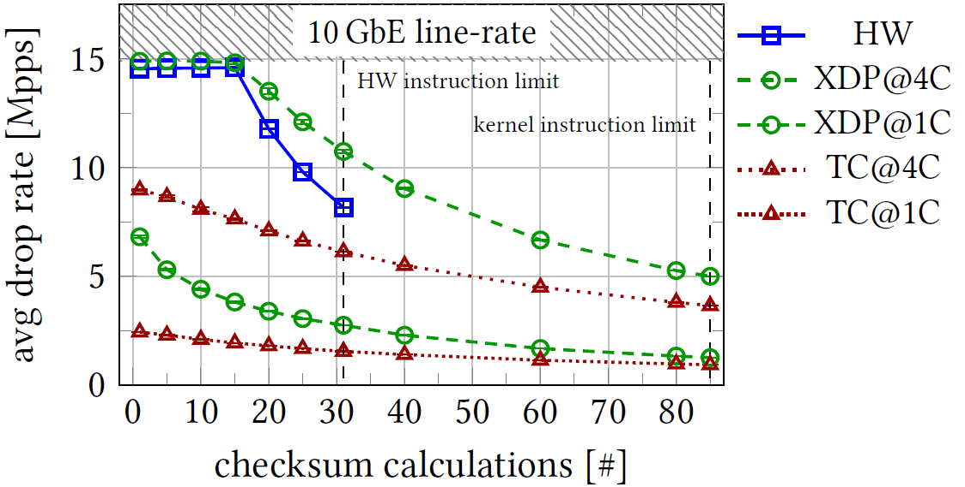
SmartNIC Offloading (Complex program test)

Slide 22
Related Work
Previously: Offload packet
Processing to hardware
Current: Bypass the kernel:
User-land stacks
Netmap:
Bypass the Kernel!
[e.g., USENIX ATC‘12]
Mux/Demux flows on specialized NICs! [INFOCOM‘01]
Frankenstack
Per App Sockets
[Submission]
Offload computation
partly to GPUs! [SIGCOMM‘10]
Use per-app stacks!
[e.g., CCR‘14/, SIGCOMM‘14]
Implement TCP in user-level! [e.g., IBM Technical Report]
Optimize I/O and cache coherence! [e.g., ANCS‘12]
Build a user space
wrapper for Kernel stack!
[USITS‘01]

Slide 23
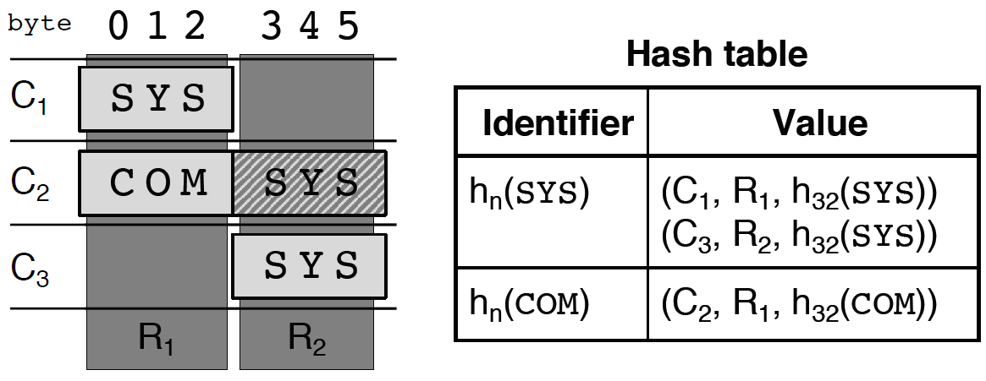
Condition Matching via Hashes

Slide 24
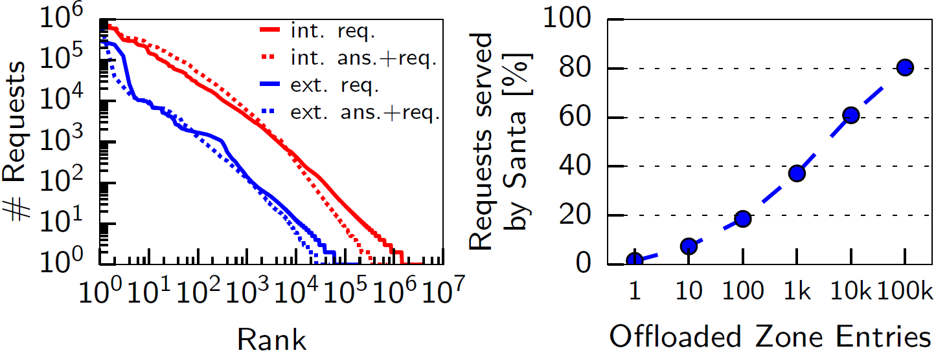
DNS Real World Workload

